Slide 1
Building iOS Swift apps
5030-201720_MCS5993_M: 5030-Topics in Computer Science
5031-201720_MCS4993_M: 5031-Topics in MA/CS

Slide 2
Agenda
UI Design
Constraints
SQLite
App Store

Slide 3
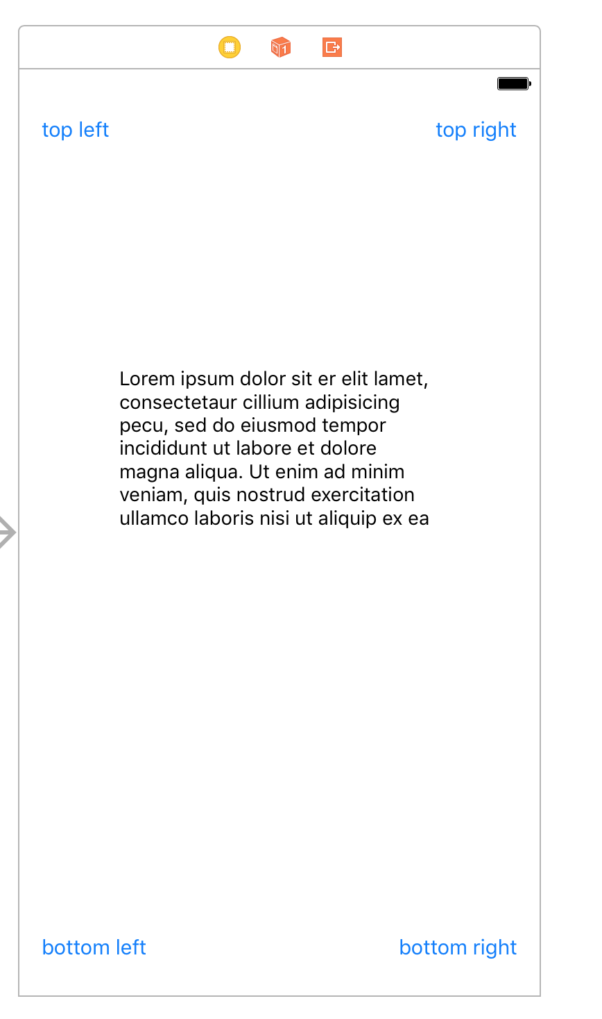
Constraints

Slide 4
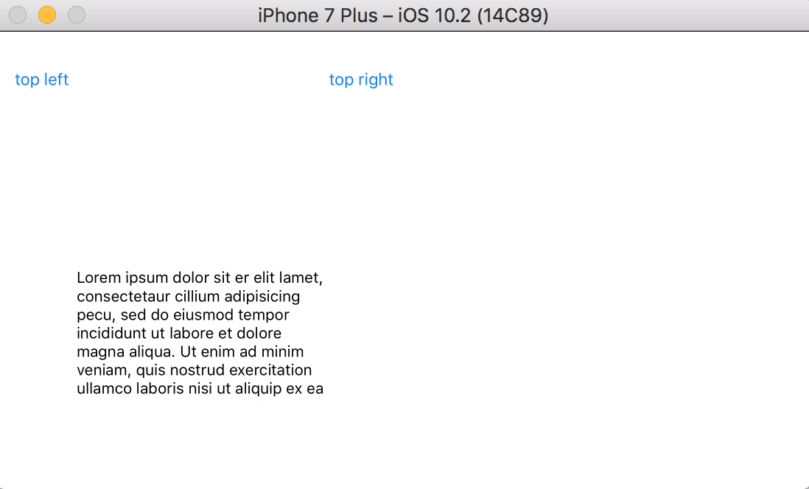
Constraints

Slide 5
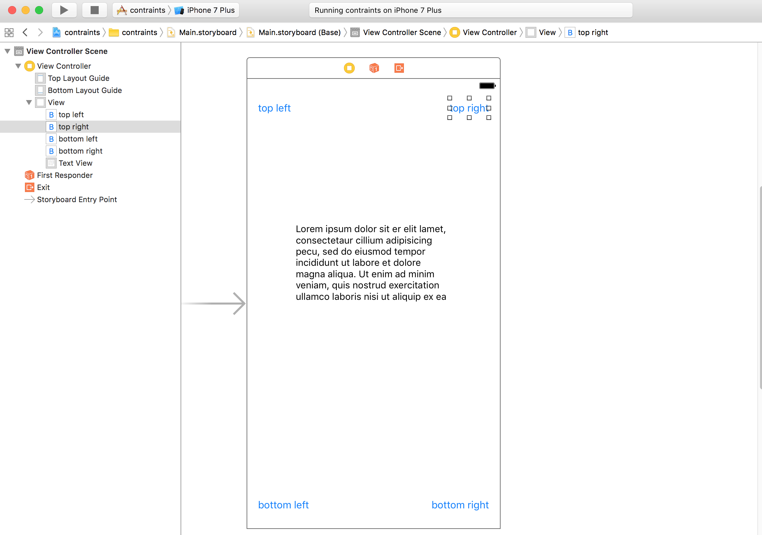
Constraints

Slide 6
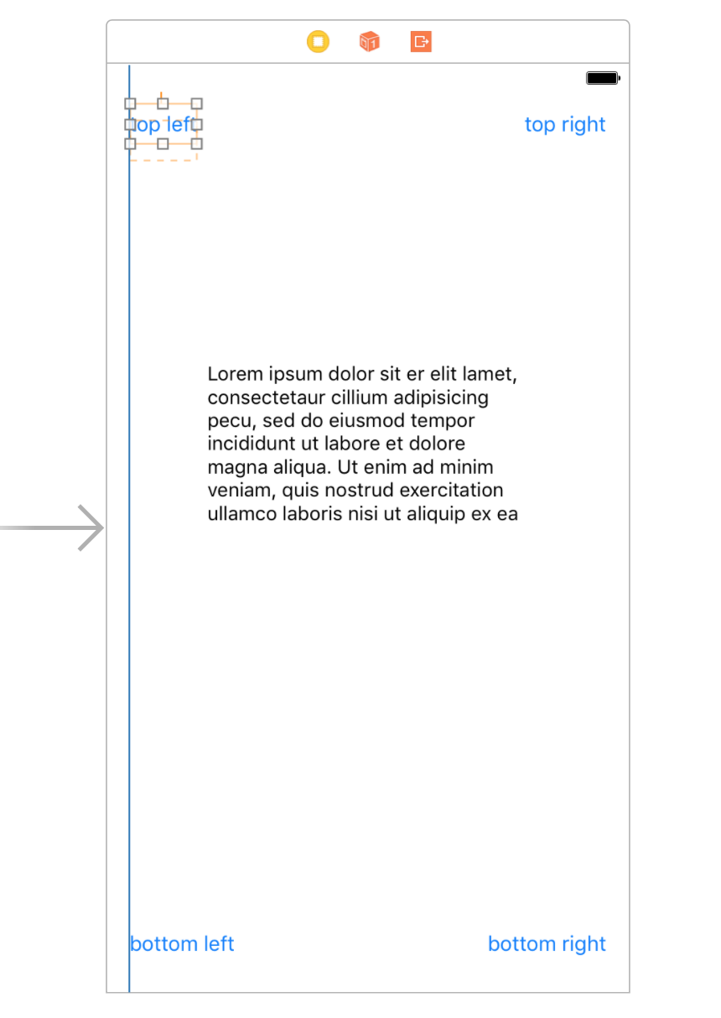
Constraints

Slide 7
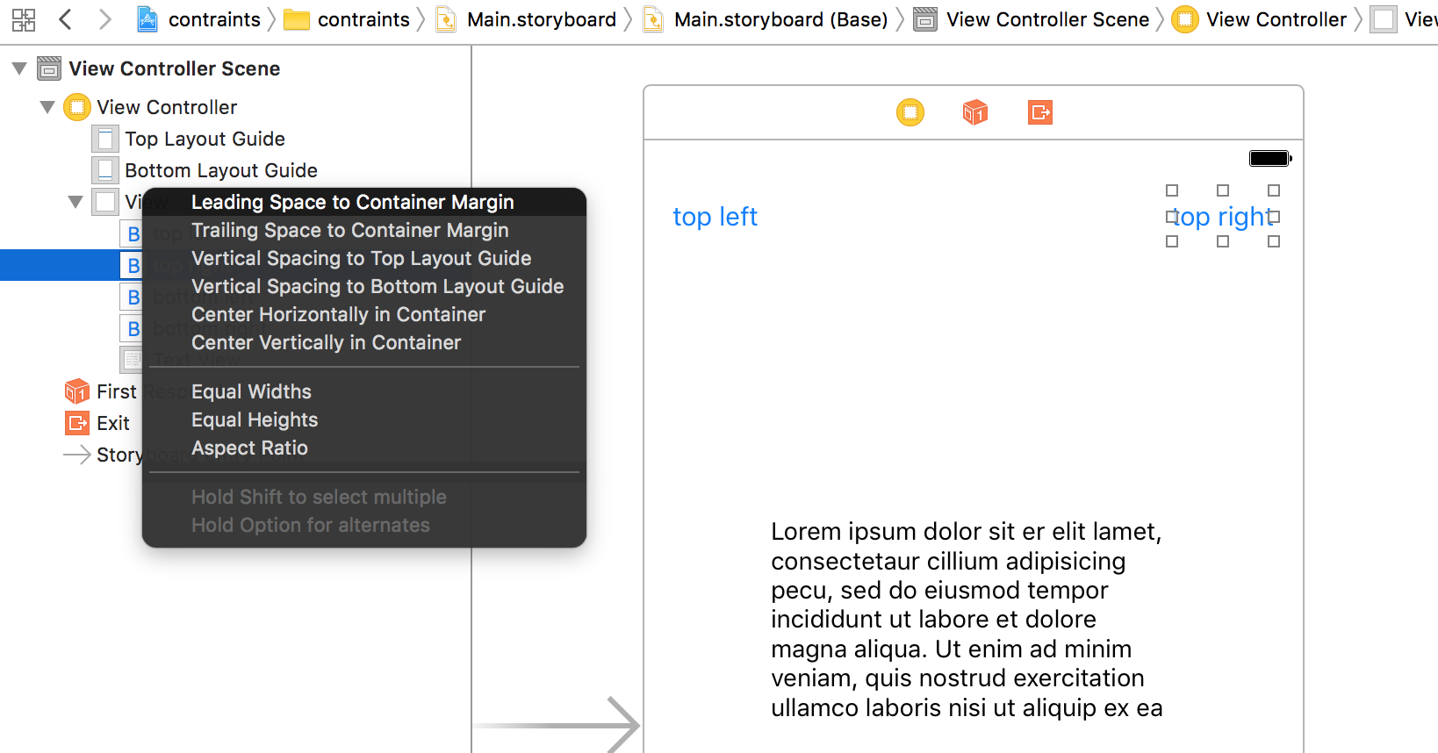
Constraints

Slide 8
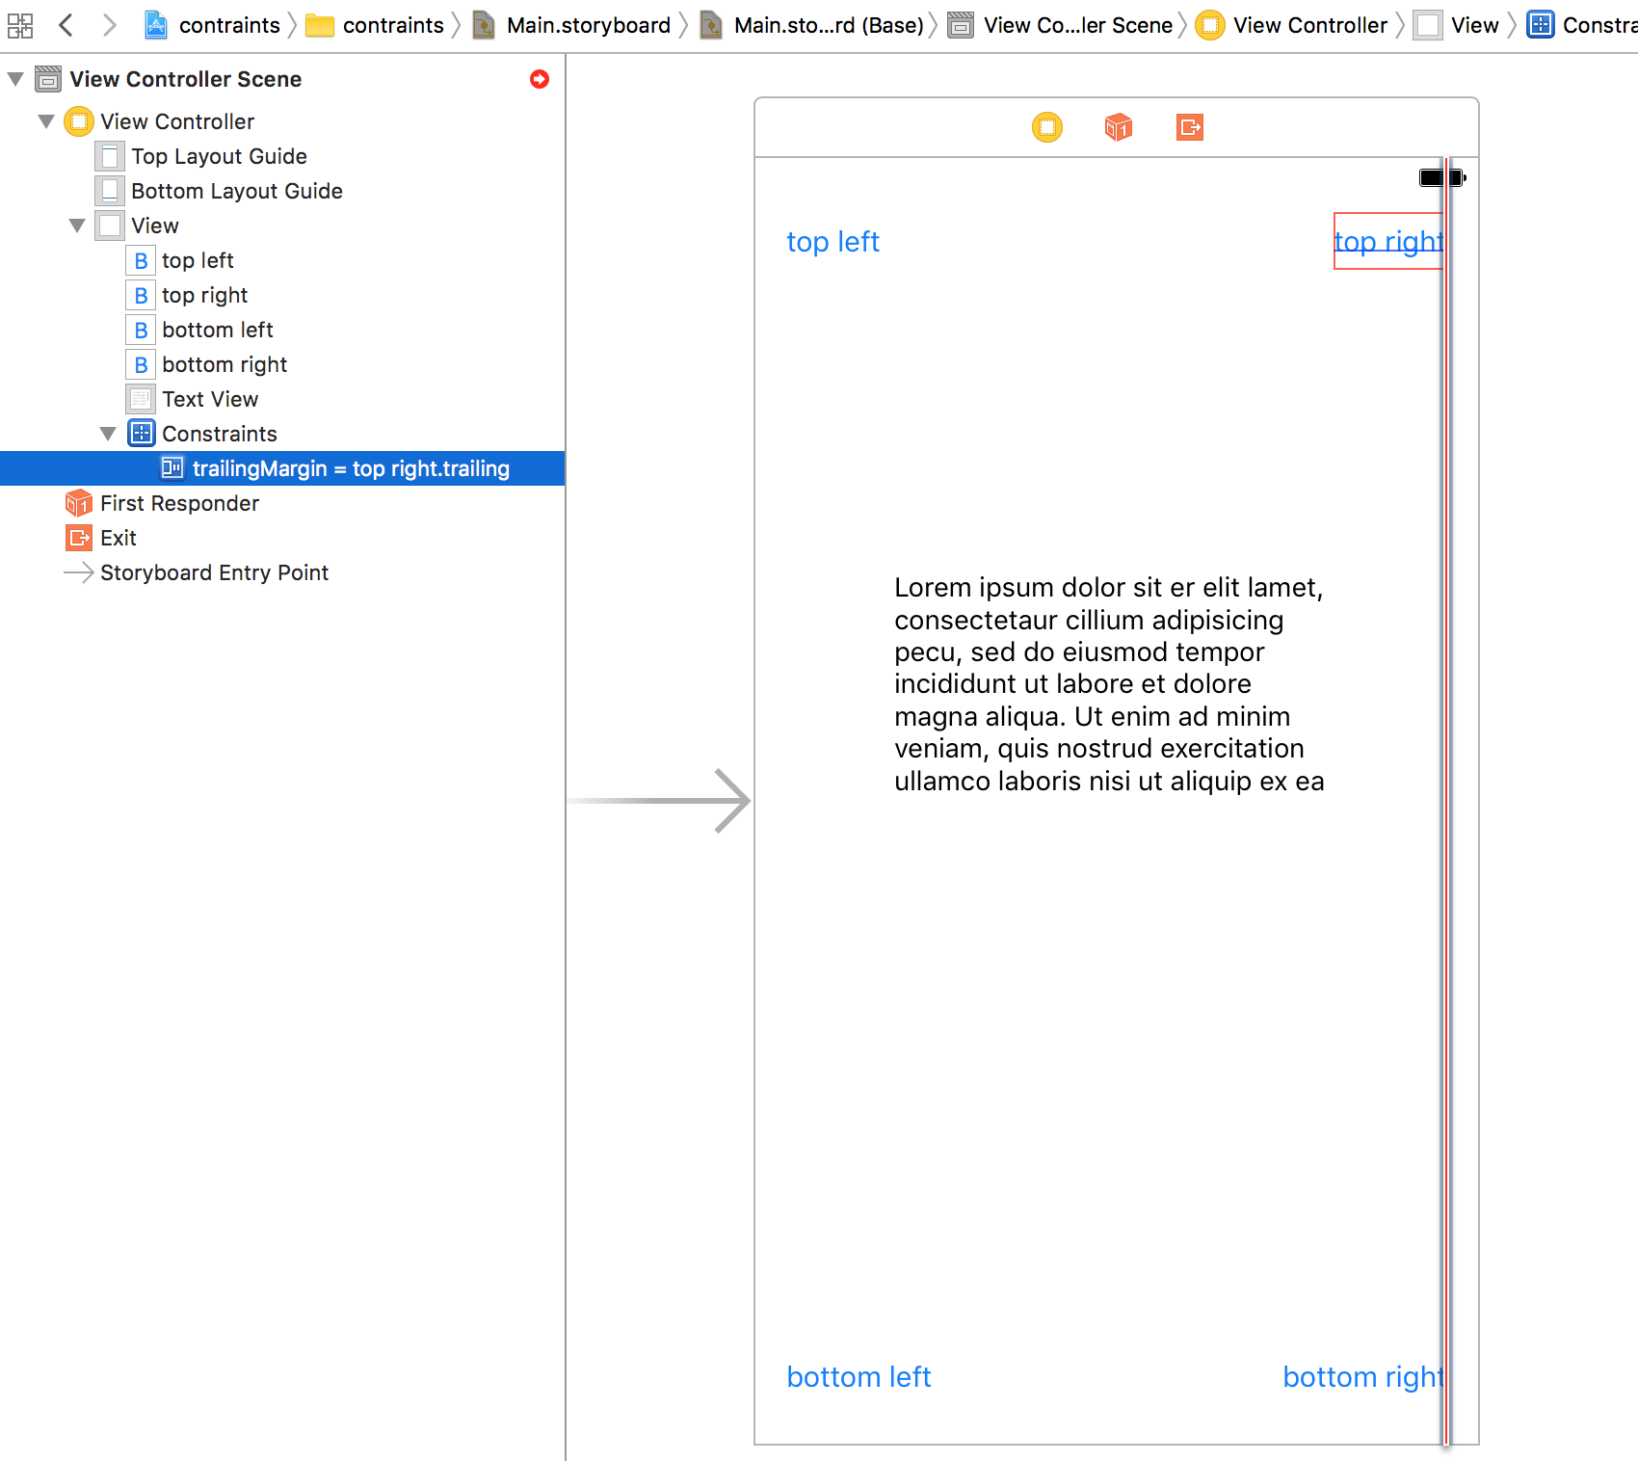
Constraints

Slide 9
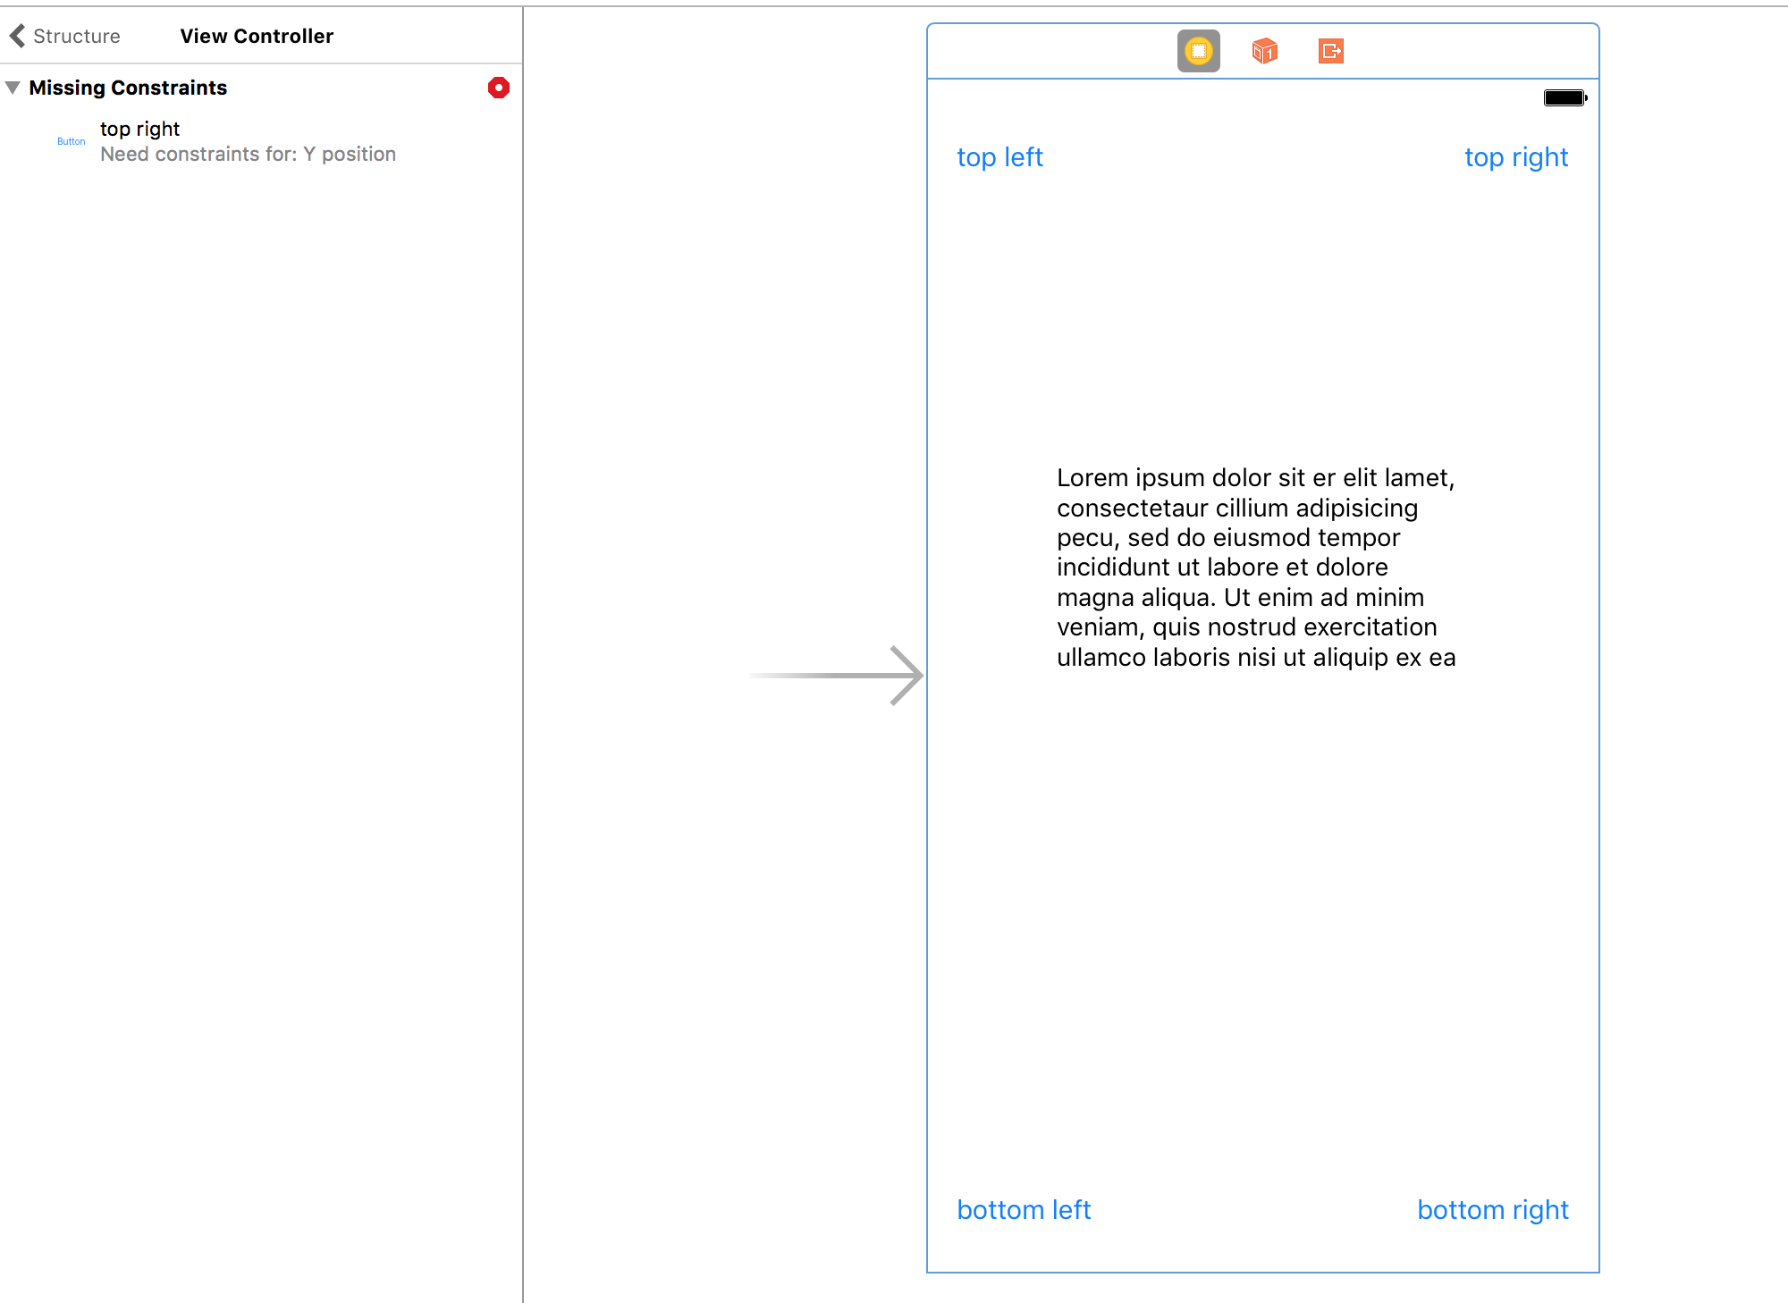
Constraints

Slide 10
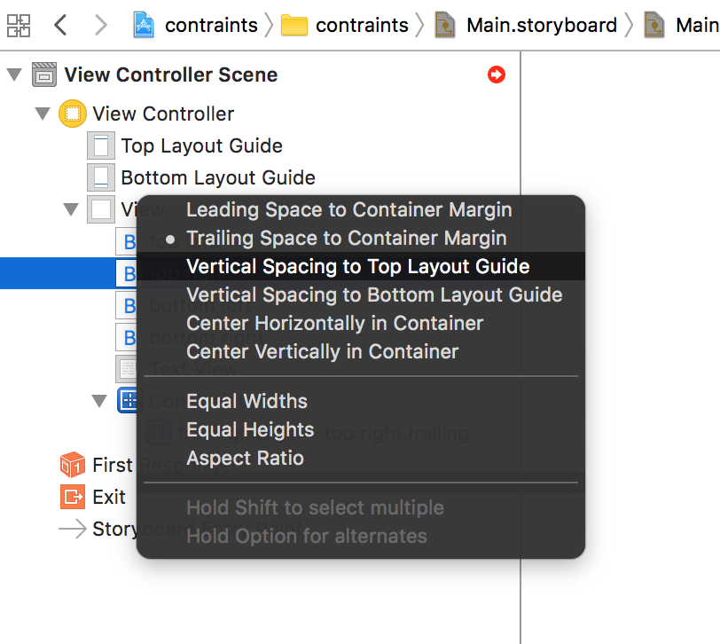
Constraints

Slide 11
Constraints

Slide 12
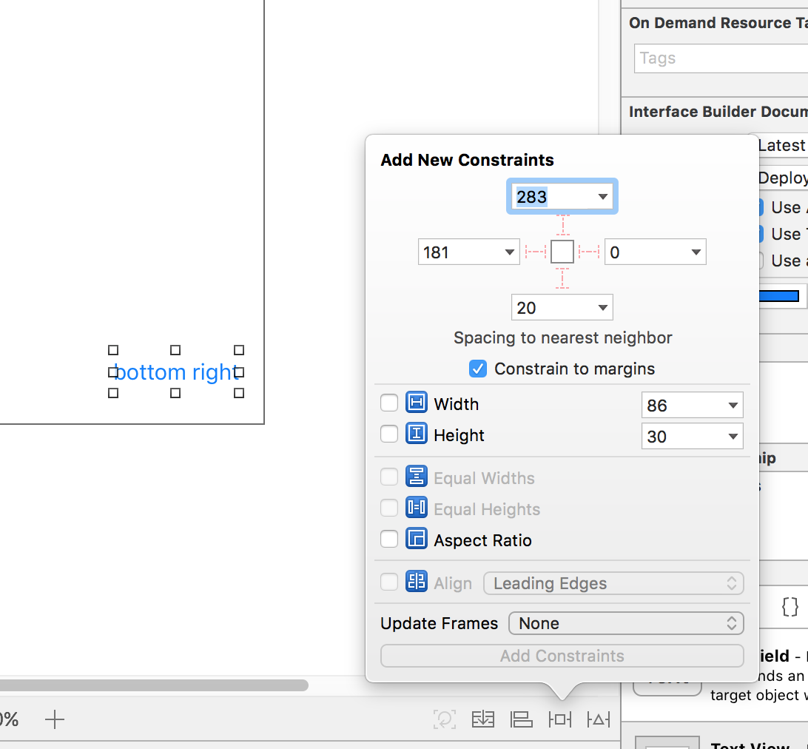
Constraints
Notes:
Want to fix the bottom right

Slide 13
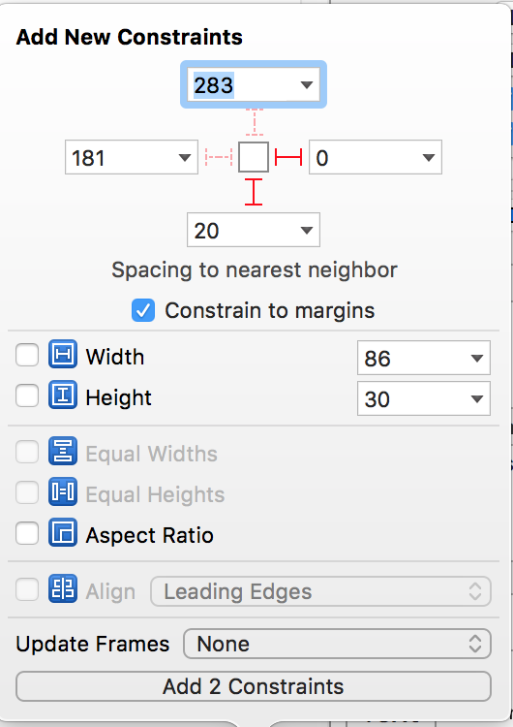
Constraints
Notes:
Want to fix the bottom right

Slide 14
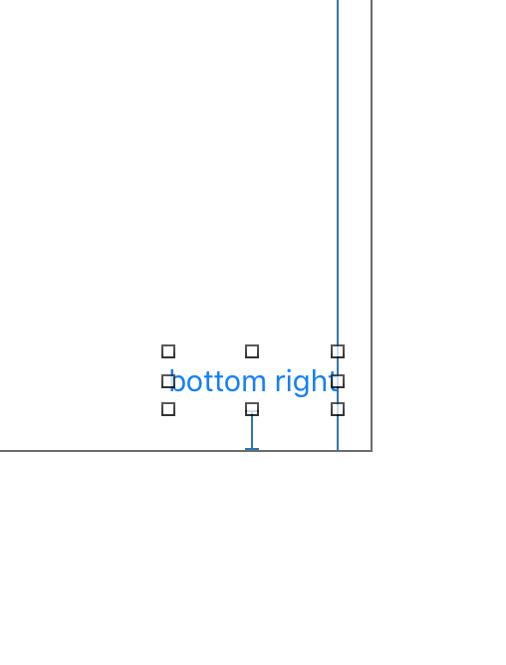
Constraints
Notes:
Want to fix the bottom right

Slide 15
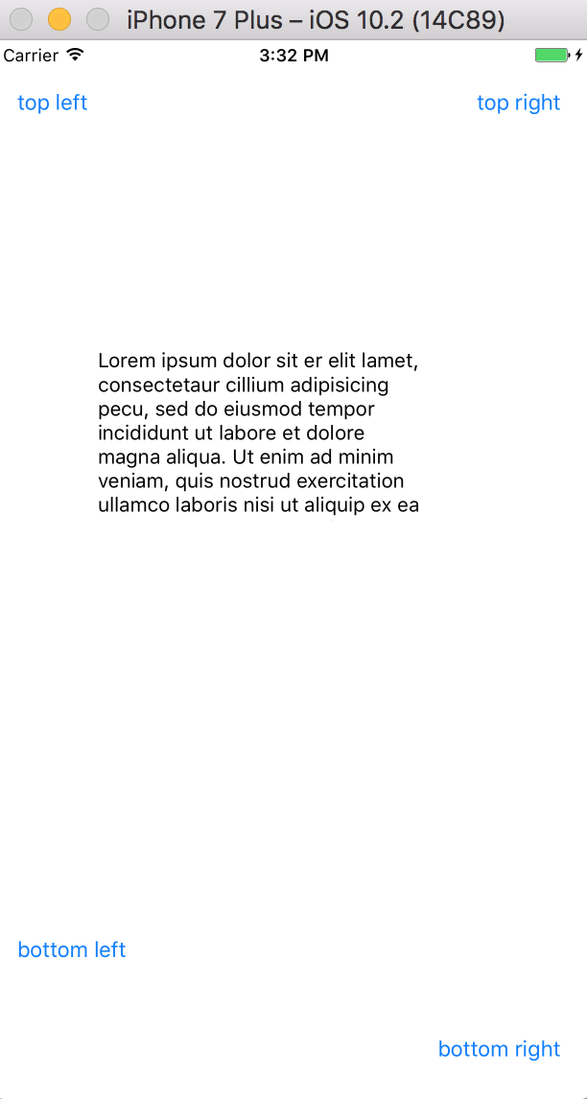
Constraints
Notes:
Want to fix the bottom right

Slide 16
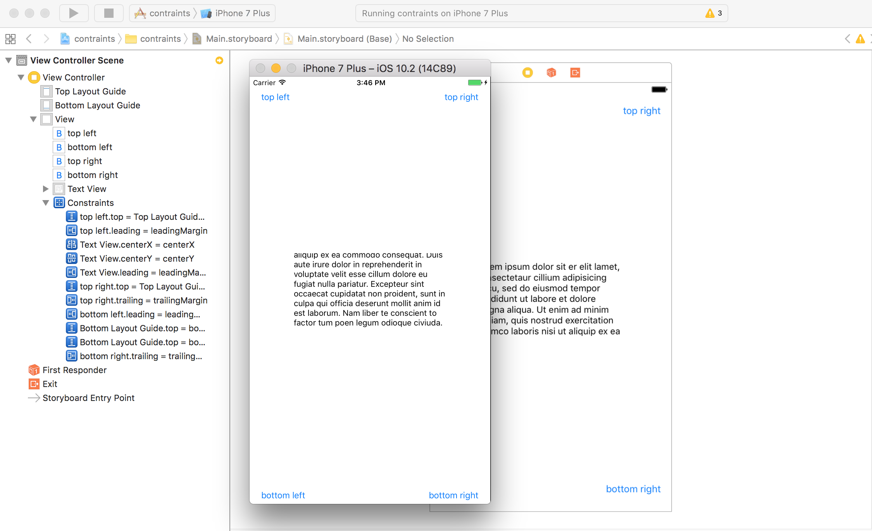
Constraints

Slide 17
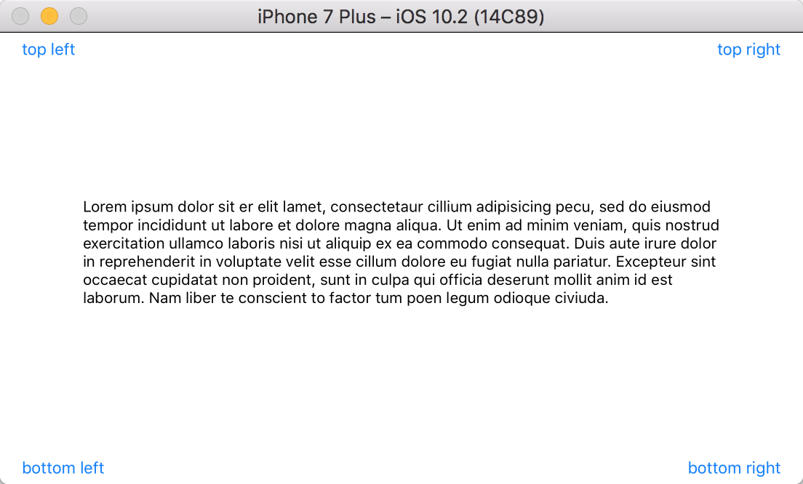
Constraints
Notes:
Don’t forget to click on the Add 2 Constraints.

Slide 18
SQLite
What is it?
Persistent data source
Multiple rows data
Not key-value pairs

Slide 19
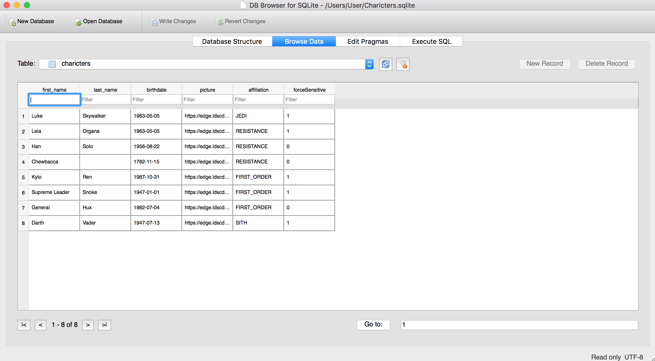
SQLite

Slide 20
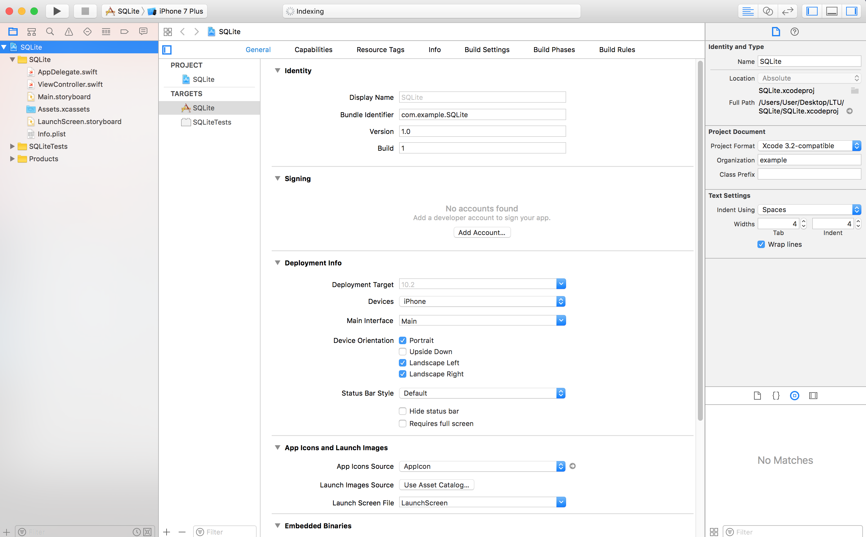
Notes:
Create a SQLite demo project

Slide 21
SQLite
pod init
vi Podfile

Slide 22
SQLite
use_frameworks!
pod 'SQLite.swift',git:'https://github.com/stephencelis/SQLite.swift.git'

Slide 23
SQLite
pod install
Open xcworkspace

Slide 24
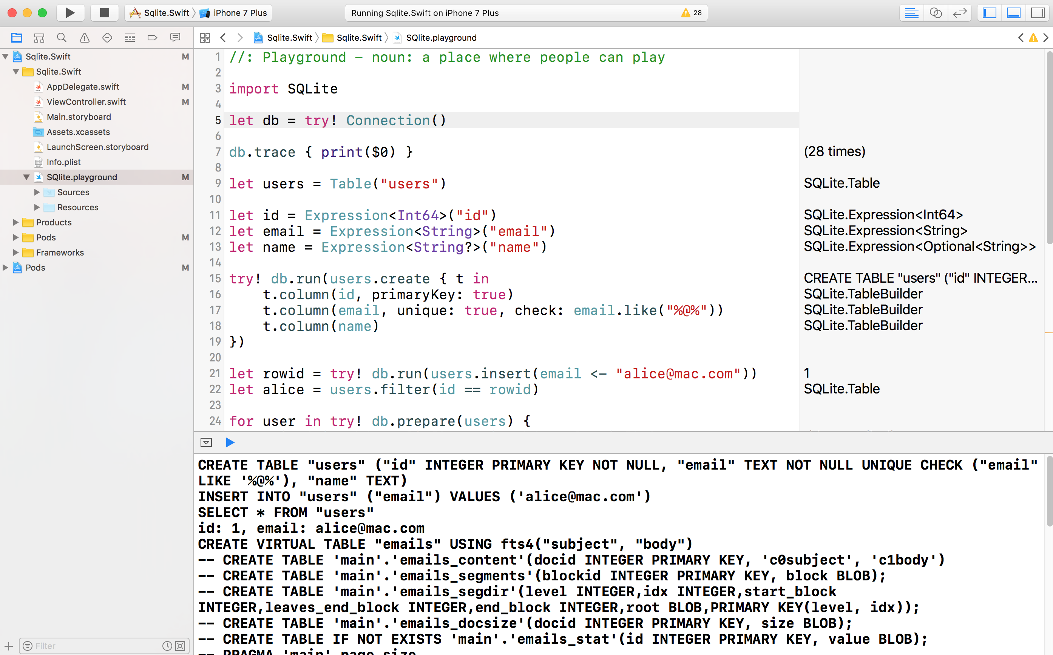
SQLite

Slide 25
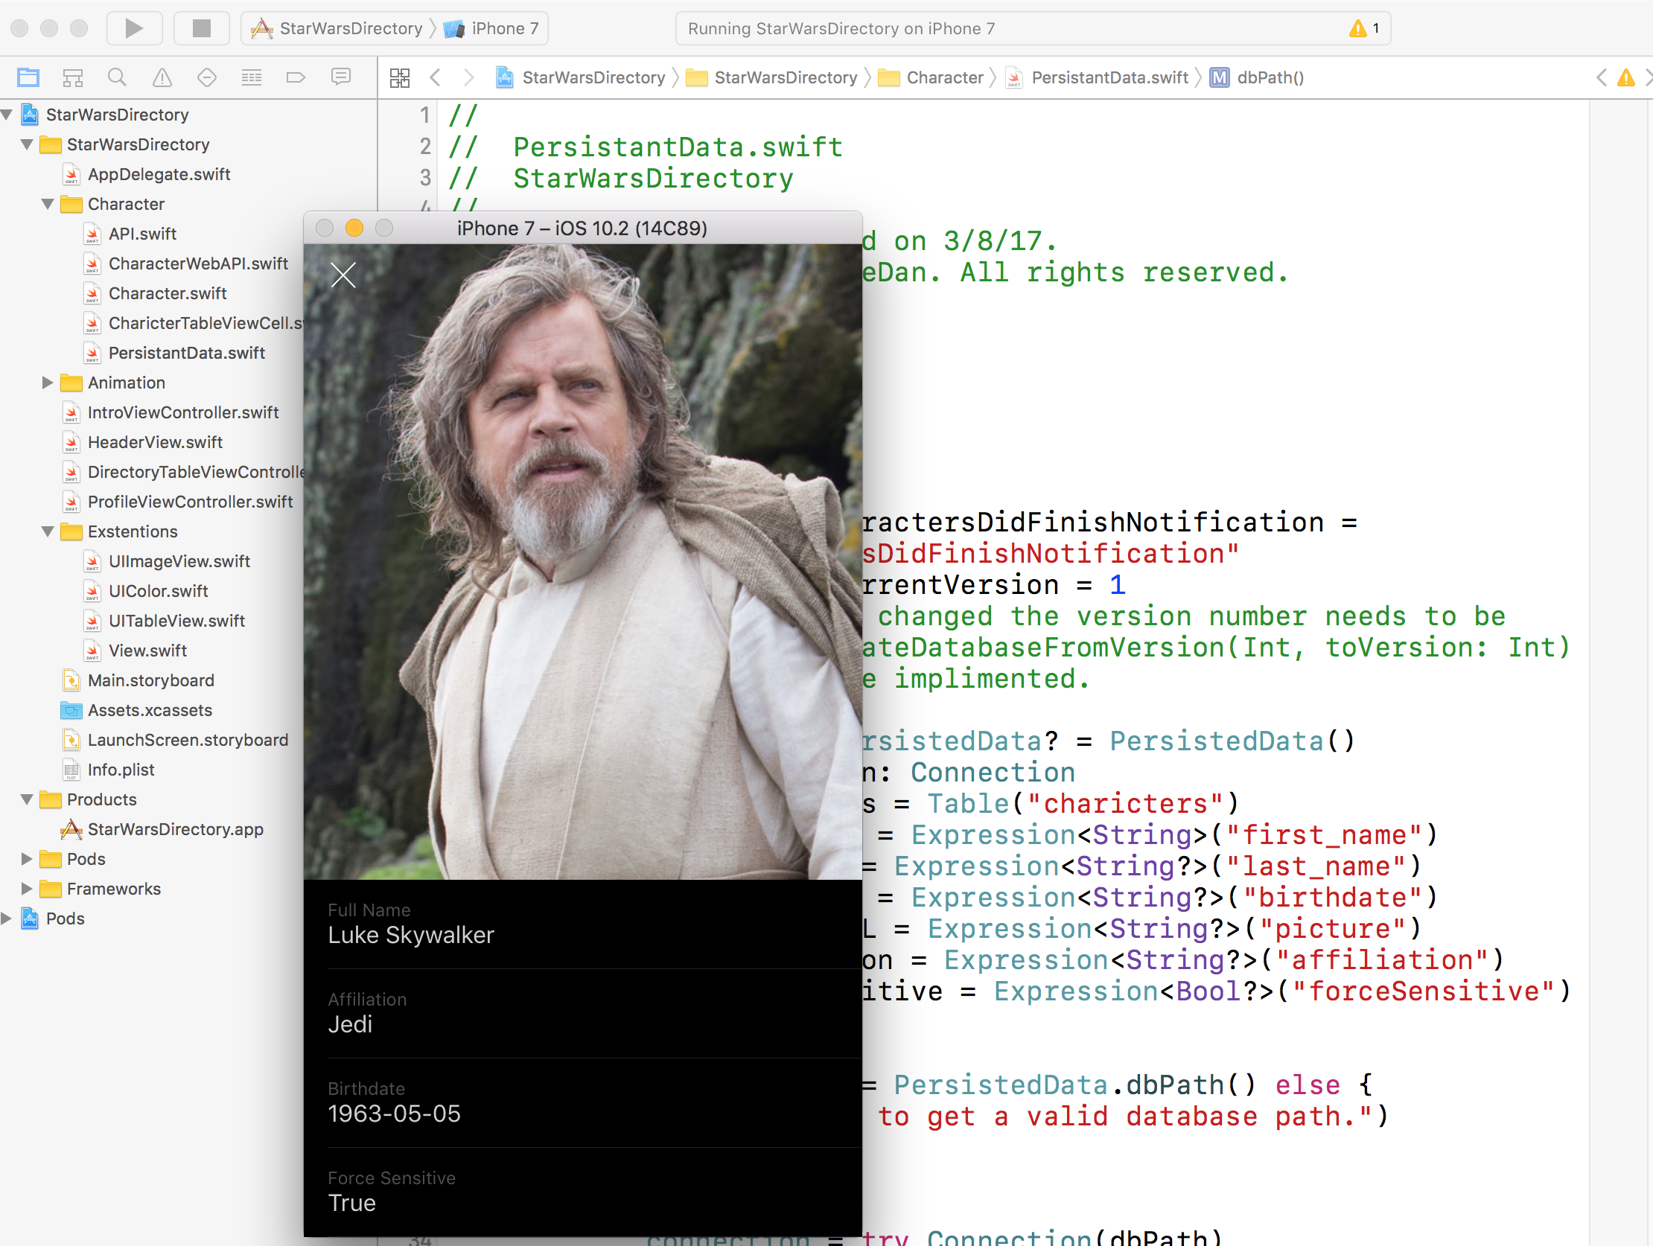
SQLite

Slide 26
Submit app to app store
Prerequisites
Project that is ready for submission and passes Apple’s App Store Guidelines
Valid Apple developer program account (not the Apple Developer Enterprise Program)
Xcode
Keychain Access
Notes:
https://clearbridgemobile.com/how-to-submit-an-app-to-the-app-store/

Slide 27
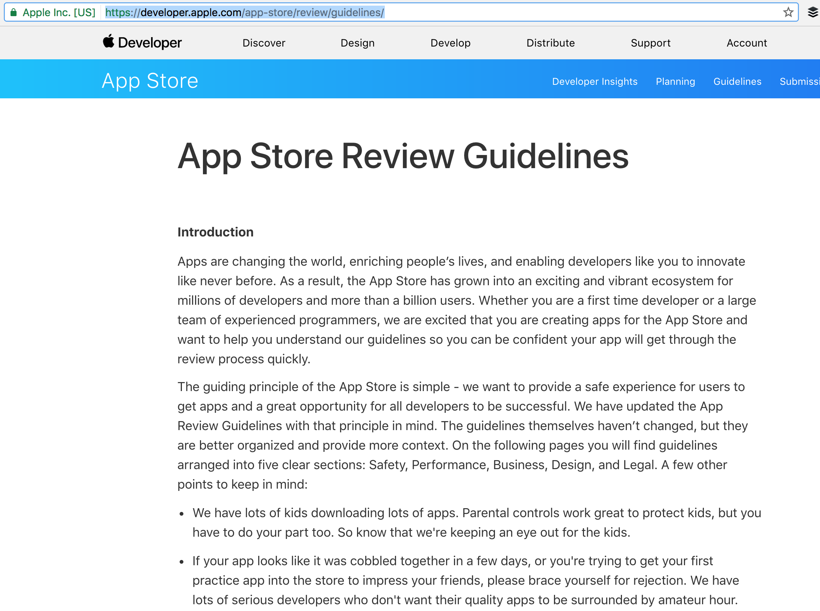
Notes:
https://developer.apple.com/app-store/review/guidelines/
List checklist

Slide 28
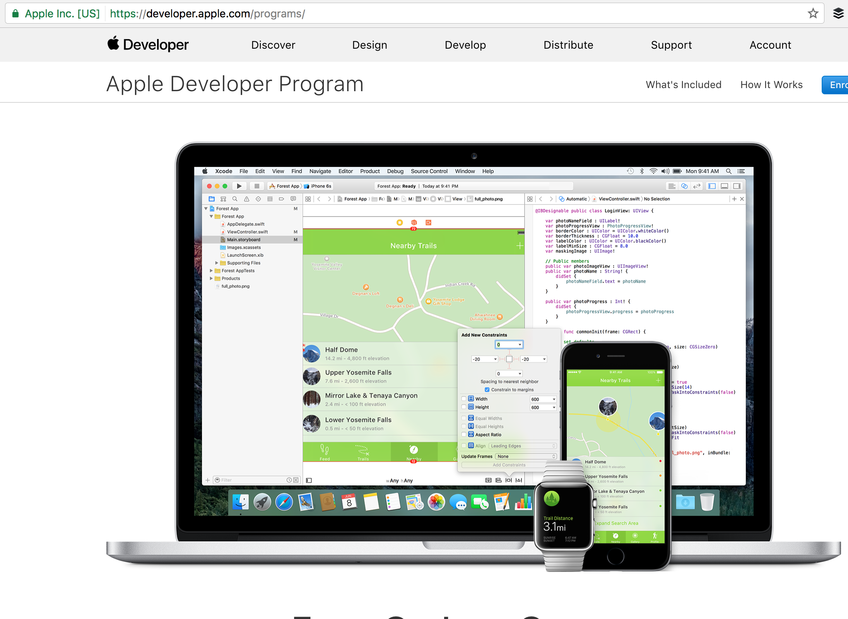
Notes:
https://developer.apple.com/programs/

Slide 29
Step Overview
Assemble App
Store Information
Create a Bundle Identifier
Create a Certificate Signing Request
Create an App Store Production Certificate
Create a Production Provisioning Profile
Create an App Store Listing
Create a Release Build
Fill in the Version Information
Submit Version for Review
Release

Slide 30
Requirements | Notes
Screenshots | You need at least one for every supported device screen size. The screenshots cannot contain transparency
Name | Name of the app as seen by users
Description | A description of your app, detailing features and functionality
Keywords | Separate keywords with a comma
Support URL | A URL with support information for your app
Marketing URL | A URL with marketing information about your app, optional
Privacy Policy URL | A URL containing your app’s privacy policy, optional
App Icon | This icon will be used on the App Store and must be in the JPG or PNG format, with a minimum resolution of at least 72 DPI, and in the RGB color space. It must not contain layers or rounded corners.
Categories | Secondary category is optional
Rating | Generate your rating based on the questionnaire
Copyright | Use the format: YYYY Company Name
Trade Representative Contact Information | Only appears on the Korean App Store, optional
Demo Account | “The username and password for a full-access account for your app. Include details for additional accounts in the Notes field.”
Notes:
Store Information

Slide 31
Create a Bundle Identifier
In your browser, navigate to https://itunesconnect.apple.com
Log in
Click Identifiers
Click the “+” in the top right of the screen
Name the App ID the same as your app
Make sure the Bundle ID follows the standard naming convention: com.yourcompanyname.yourappname
Check any App Services the app needs, click Continue
Verify the services are correct, then click Submit

Slide 32
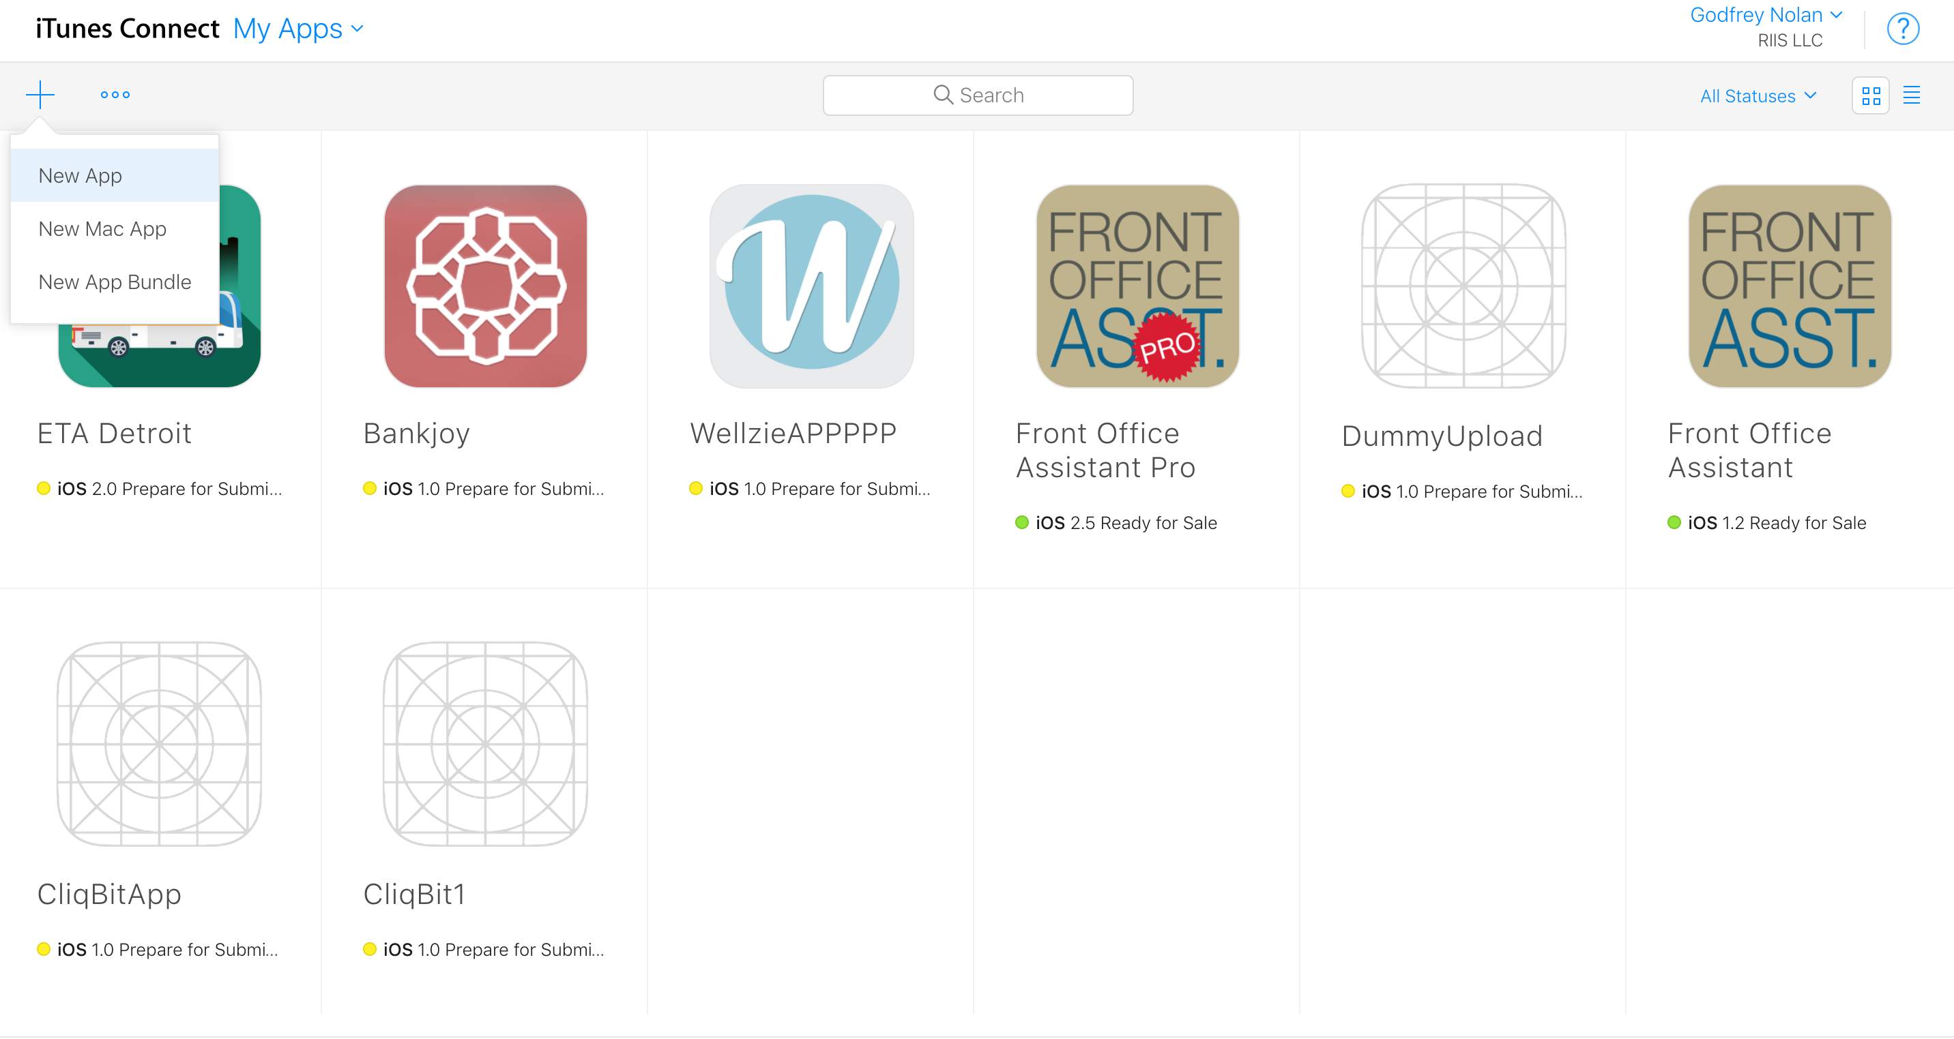

Slide 33
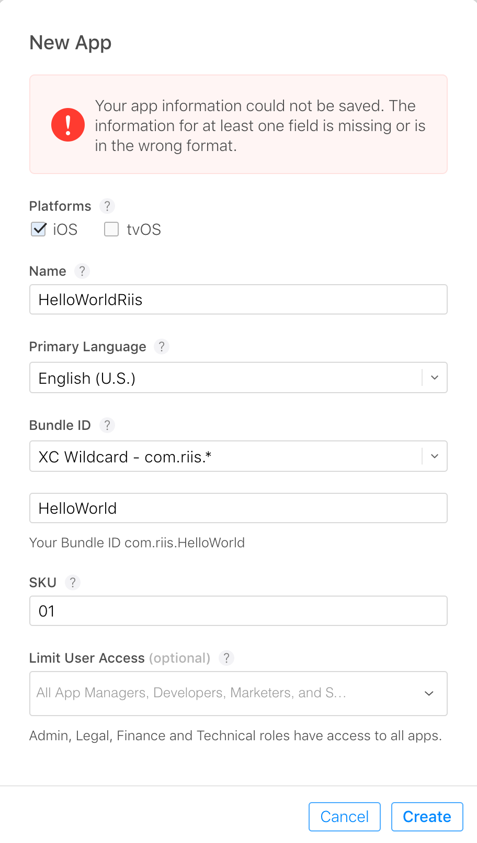

Slide 34
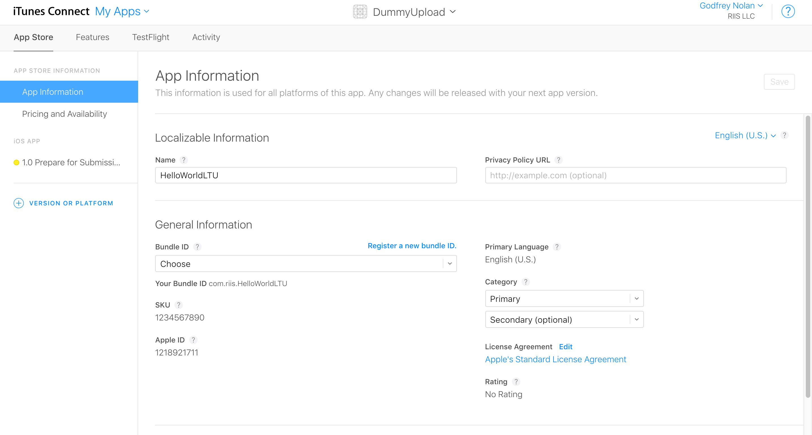

Slide 35
Create a Certificate Signing Request
Open a program called Key Chain Access
In the top left menu, click Certificate Assistant
Click Request a Certificate From a Certificate Authority…User email: Enter your email address
Common Name: We recommend using the name of the app CA email is not actually required
Check Saved to Disk, click Continue
Save the Certificate Signing Request for later
Notes:
Certificate Signing Requests are used to link your computer to your Apple developer account.

Slide 36
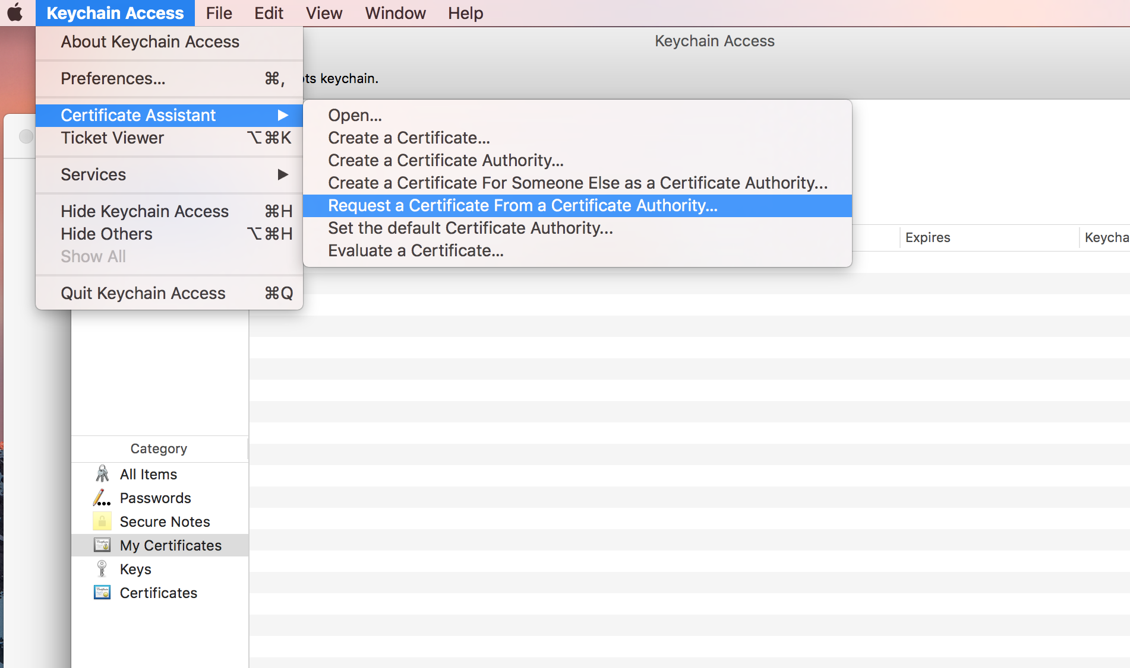

Slide 37
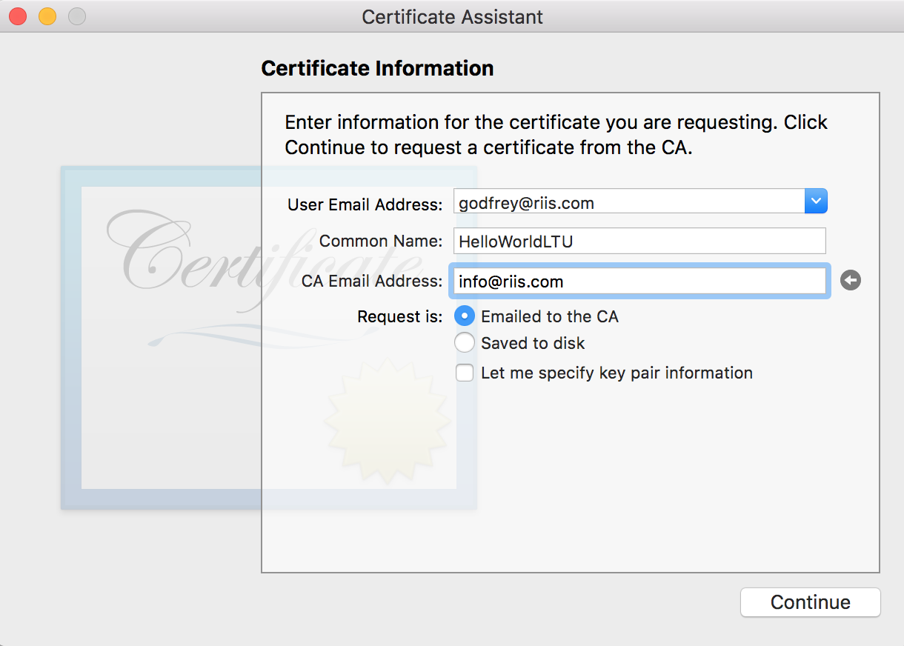

Slide 38
Create an App Store Production Certificate
In your browser, navigate to Apple’s Developer Portal
Click Certificates
Click the “+” in the top right of the screen
Click the App Store Production Currently named “App Store and Ad Hoc” under Production
Click Continue
Upload the Certificate Signing Request created earlier
Download the Certificate
Install the certificate on your computer by double clicking
Keep this file somewhere safe
Notes:
Code Signing Certificates are used to link iOS apps to your Apple developer account.

Slide 39
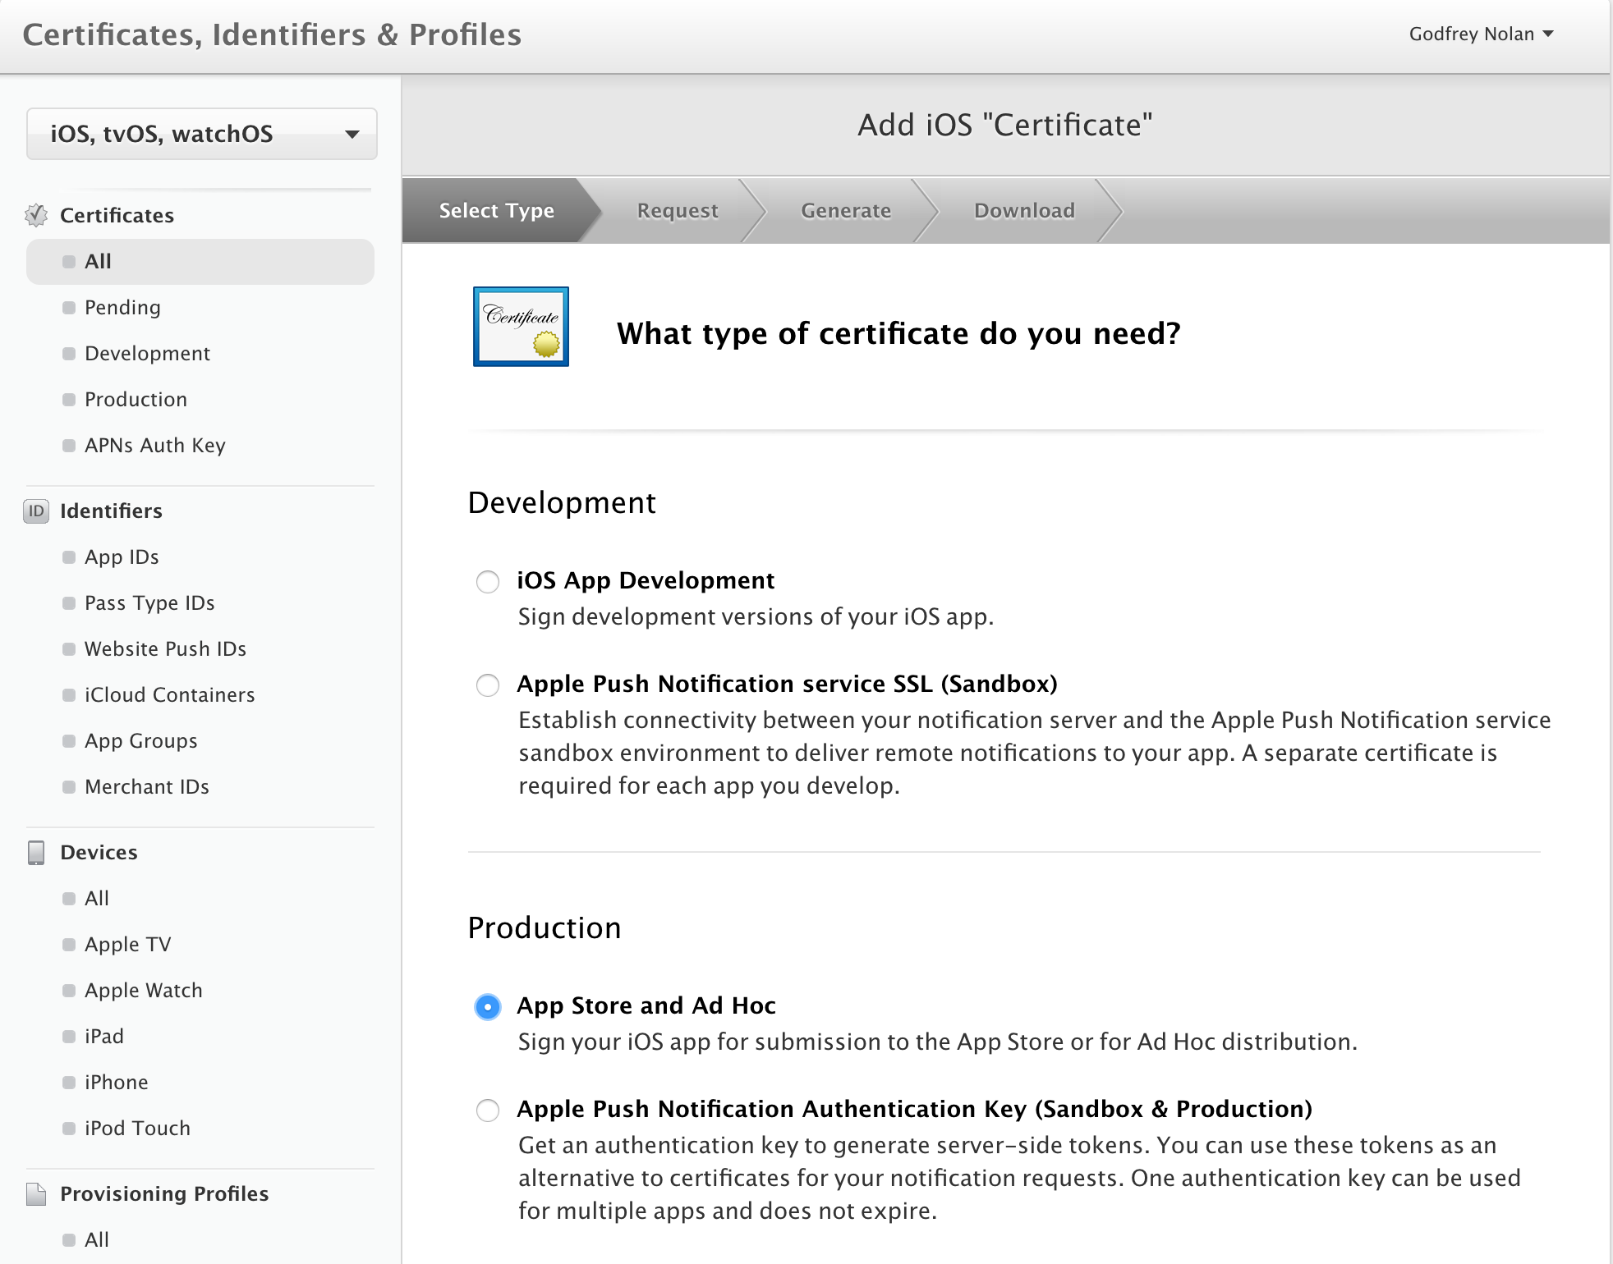

Slide 40
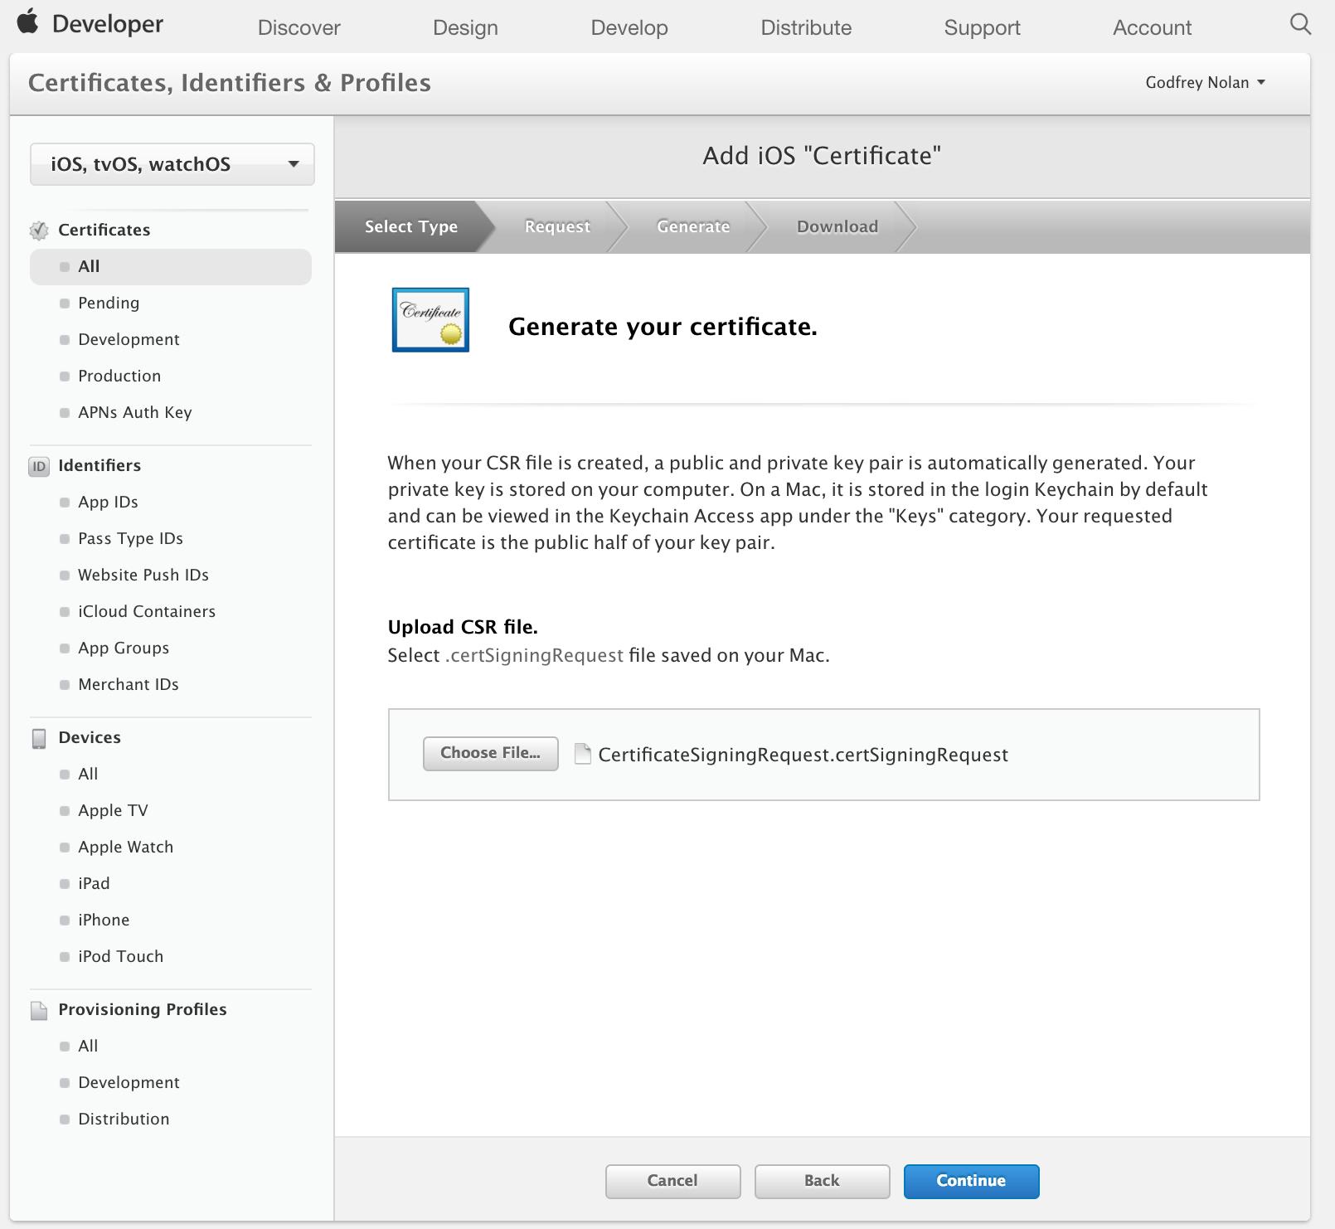

Slide 41
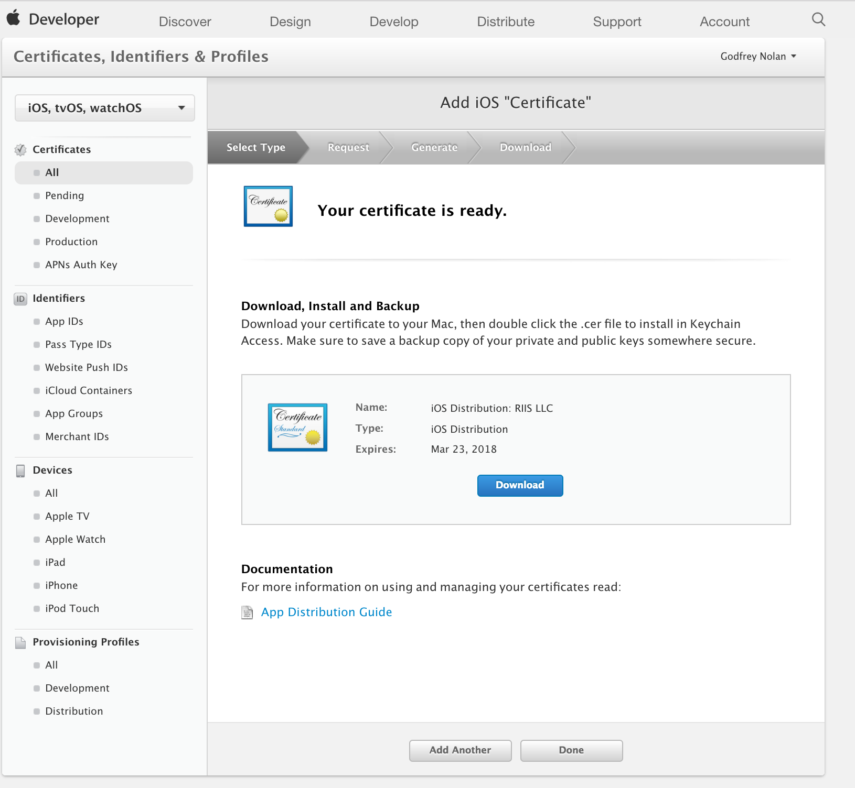

Slide 42
Create a Production Provisioning Profile
In Apple Develper Portal go to Provisioning Profiles
Click the “+” in the top right of the screen
Click the App Store Distribution option, click Continue
Select the Bundle ID created earlier, click Continue
Select the Certificate created earlier, click Continue
Make sure the Profile Name follows the standard naming convention: App Name App Store Distribution
Click Generate Download it
Install the provision profile on your computer by double clicking
Keep this file somewhere safe
Notes:
Provisioning Profiles are packaged with iOS apps so users devices can install them.

Slide 43
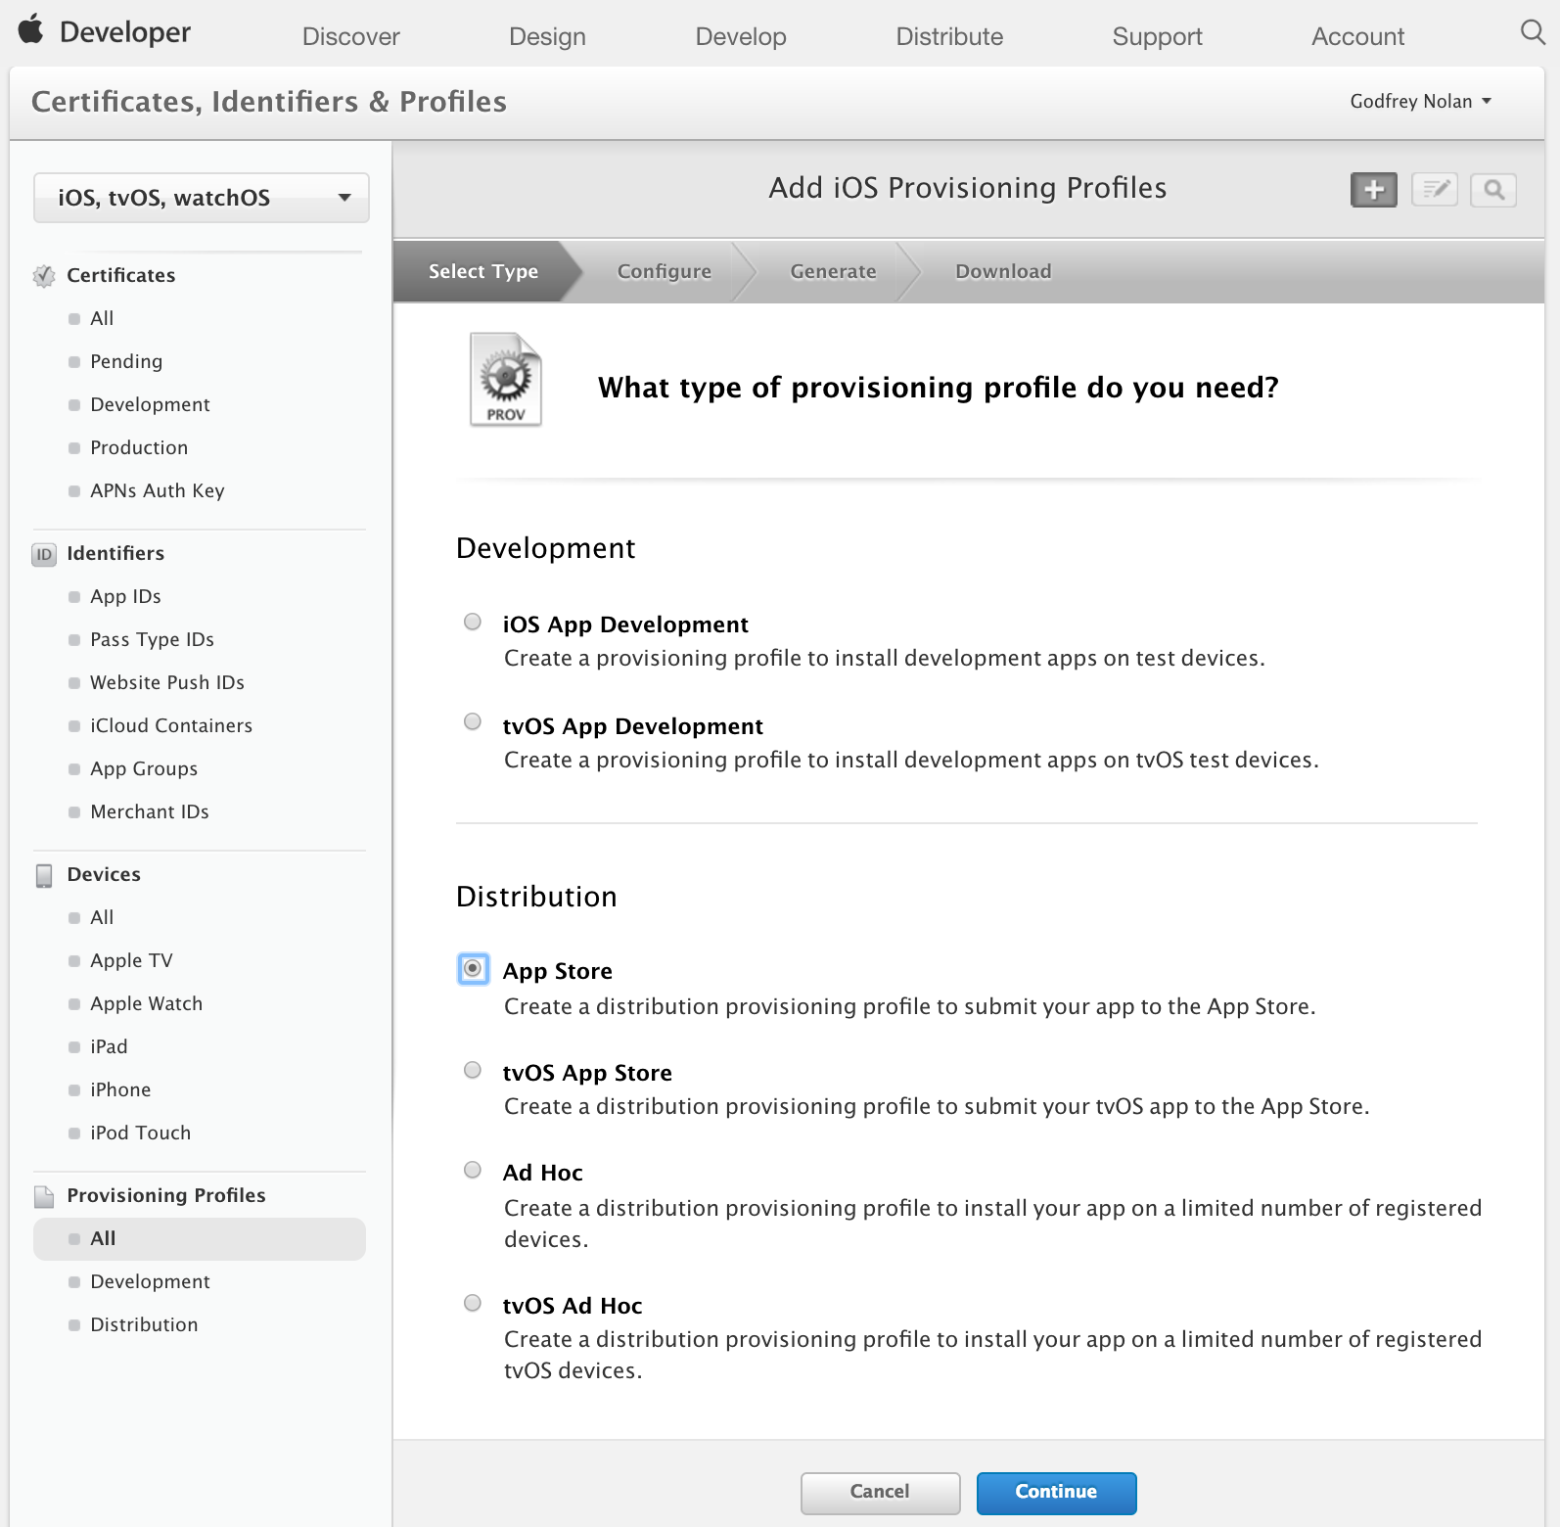
Notes:
In Apple Develper Portal go to Provisioning Profiles
Click the “+” in the top right of the screen
Click the App Store Distribution option, click Continue
Select the Bundle ID created earlier, click Continue
Select the Certificate created earlier, click Continue
Make sure the Profile Name follows the standard naming convention: App Name App Store Distribution
Click Generate Download it
Install the provision profile on your computer by double clicking
Keep this file somewhere safe

Slide 44
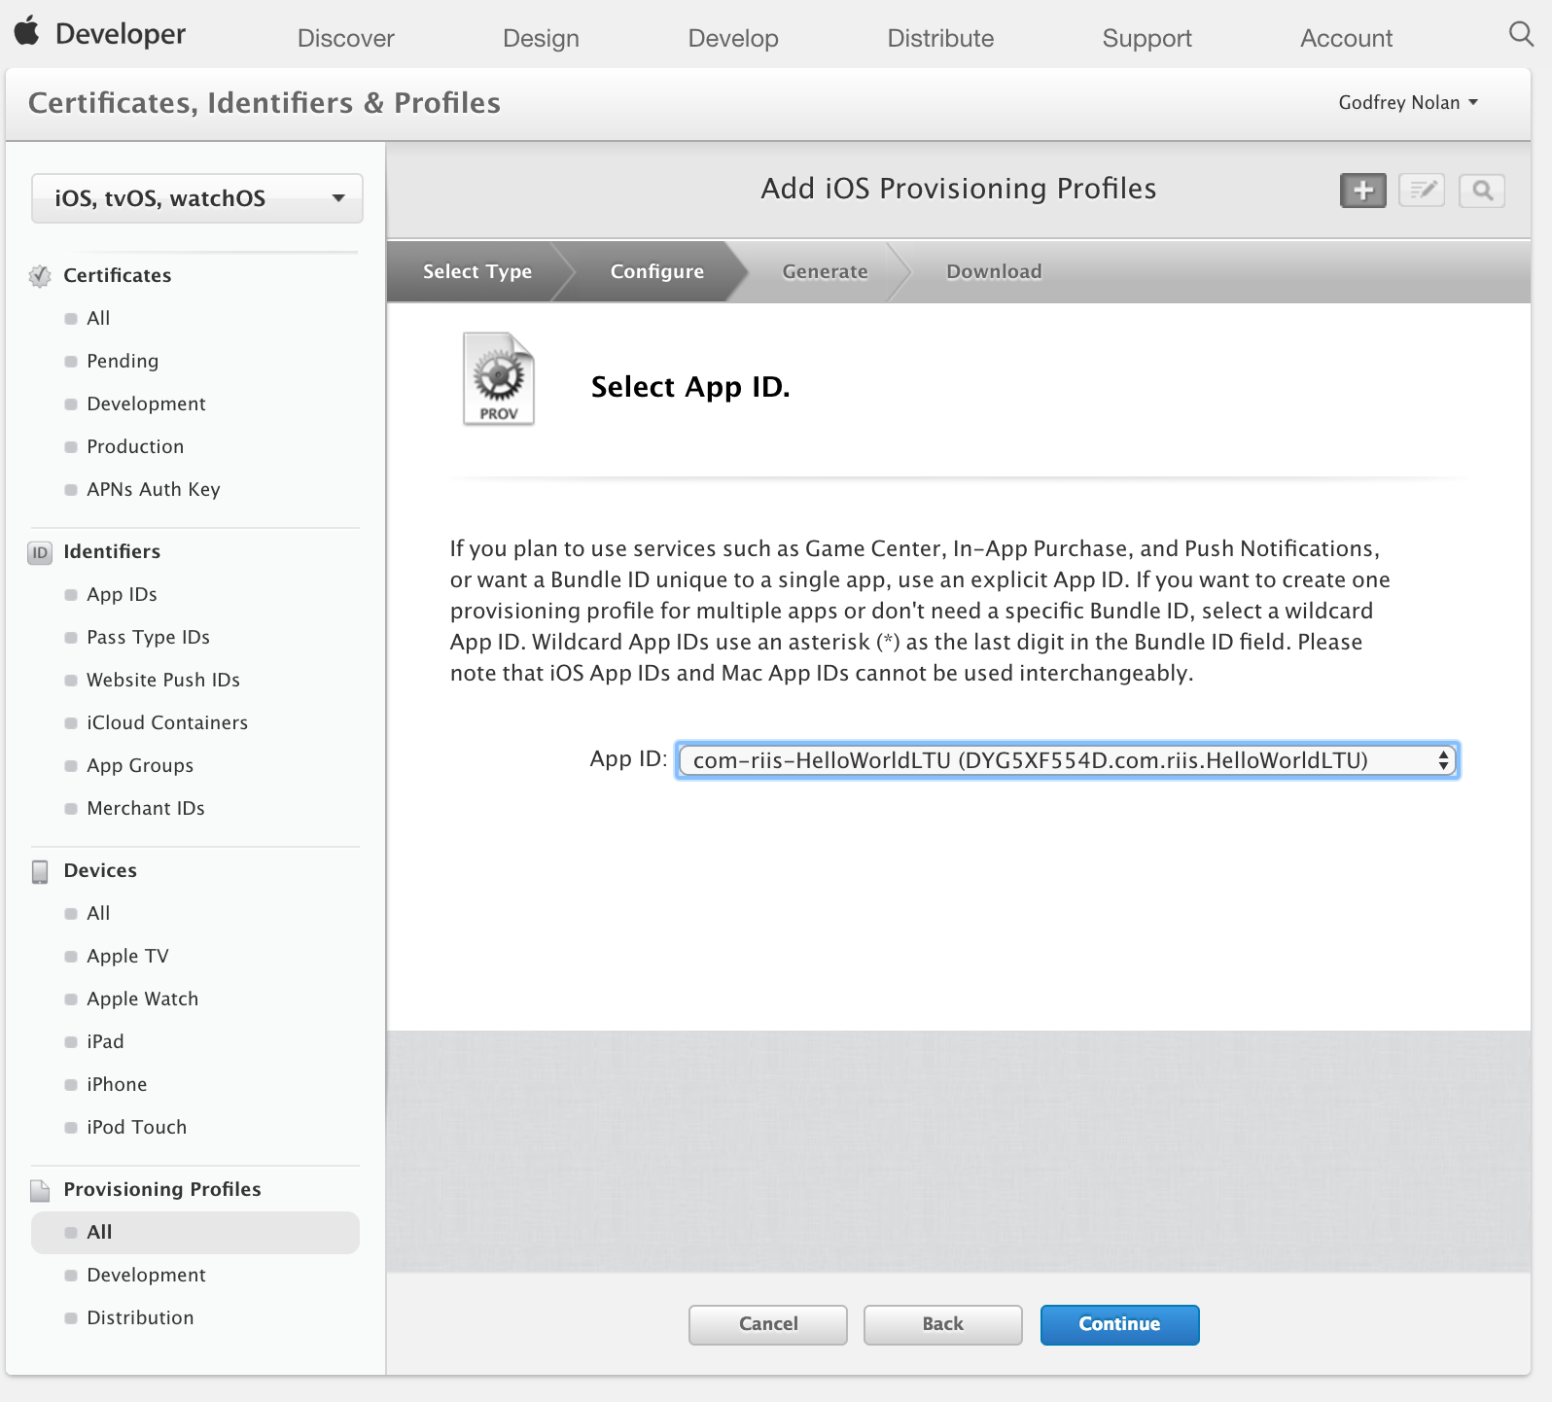
Notes:
In Apple Develper Portal go to Provisioning Profiles
Click the “+” in the top right of the screen
Click the App Store Distribution option, click Continue
Select the Bundle ID created earlier, click Continue
Select the Certificate created earlier, click Continue
Make sure the Profile Name follows the standard naming convention: App Name App Store Distribution
Click Generate Download it
Install the provision profile on your computer by double clicking
Keep this file somewhere safe

Slide 45
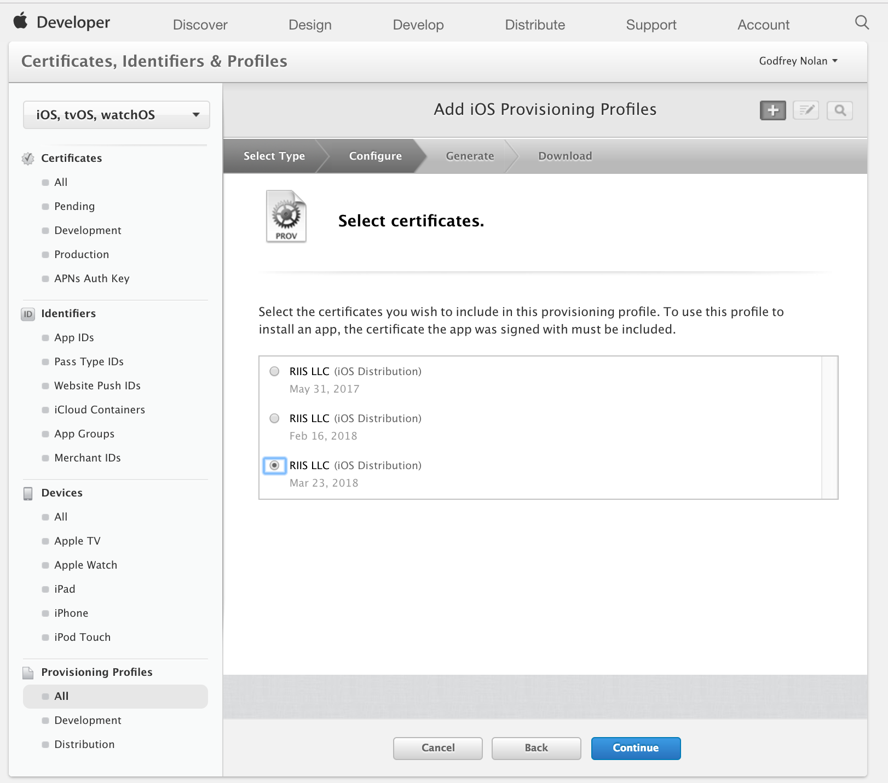
Notes:
In Apple Develper Portal go to Provisioning Profiles
Click the “+” in the top right of the screen
Click the App Store Distribution option, click Continue
Select the Bundle ID created earlier, click Continue
Select the Certificate created earlier, click Continue
Make sure the Profile Name follows the standard naming convention: App Name App Store Distribution
Click Generate Download it
Install the provision profile on your computer by double clicking
Keep this file somewhere safe

Slide 46
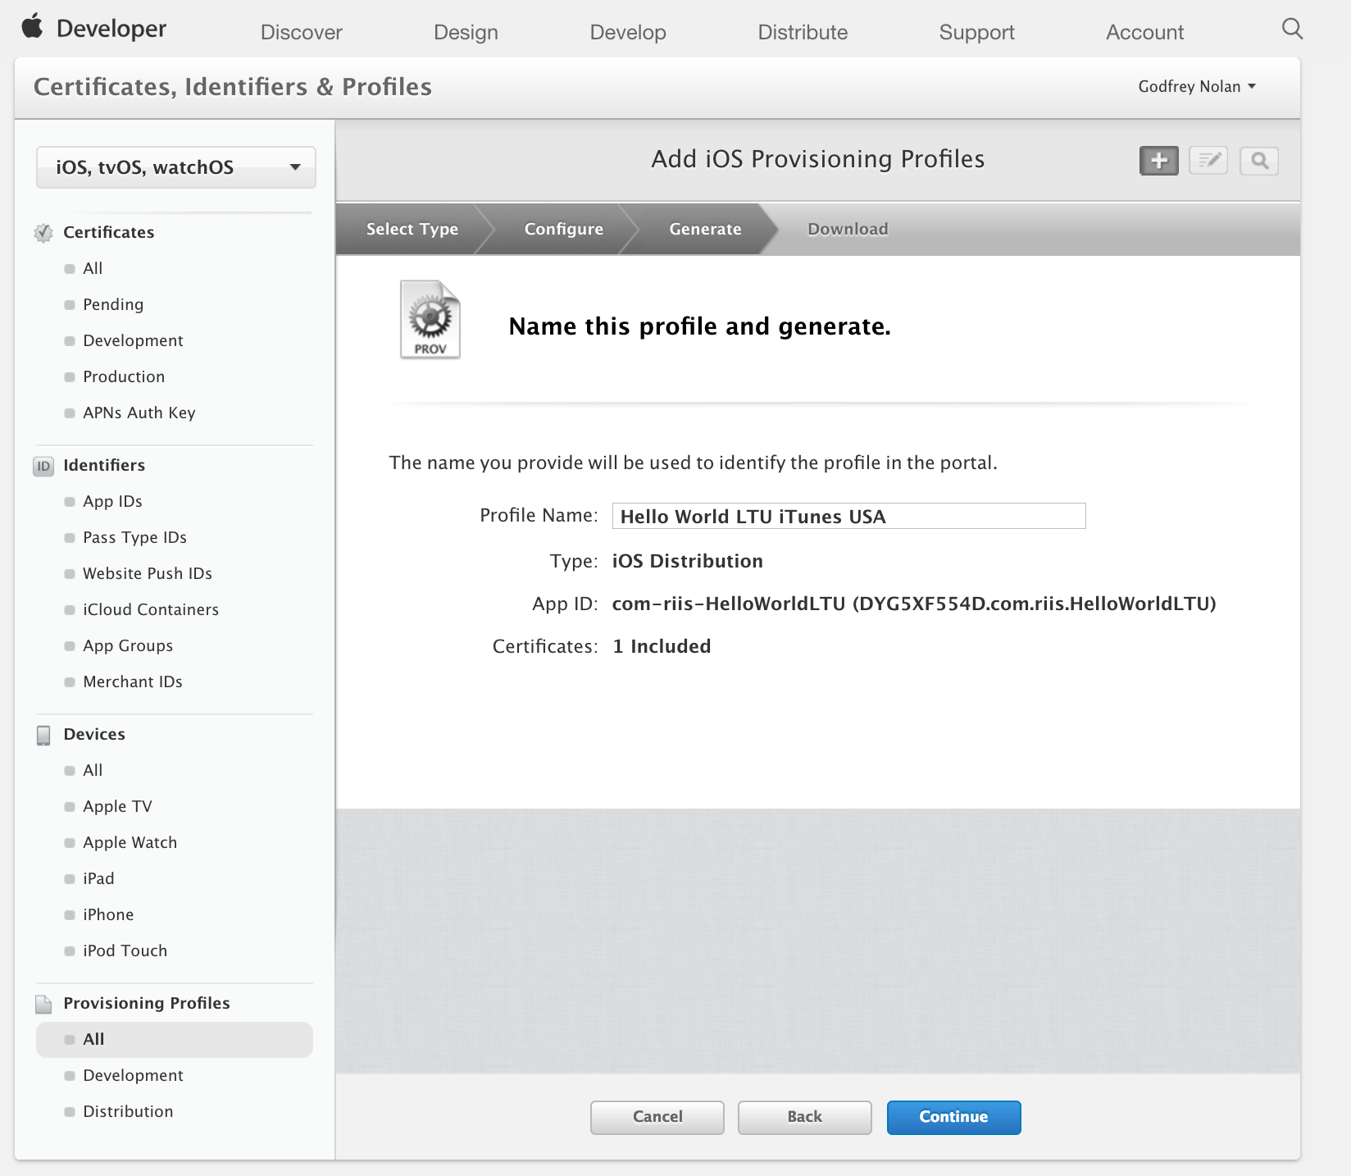
Notes:
In Apple Develper Portal go to Provisioning Profiles
Click the “+” in the top right of the screen
Click the App Store Distribution option, click Continue
Select the Bundle ID created earlier, click Continue
Select the Certificate created earlier, click Continue
Make sure the Profile Name follows the standard naming convention: App Name App Store Distribution
Click Generate Download it
Install the provision profile on your computer by double clicking
Keep this file somewhere safe

Slide 47
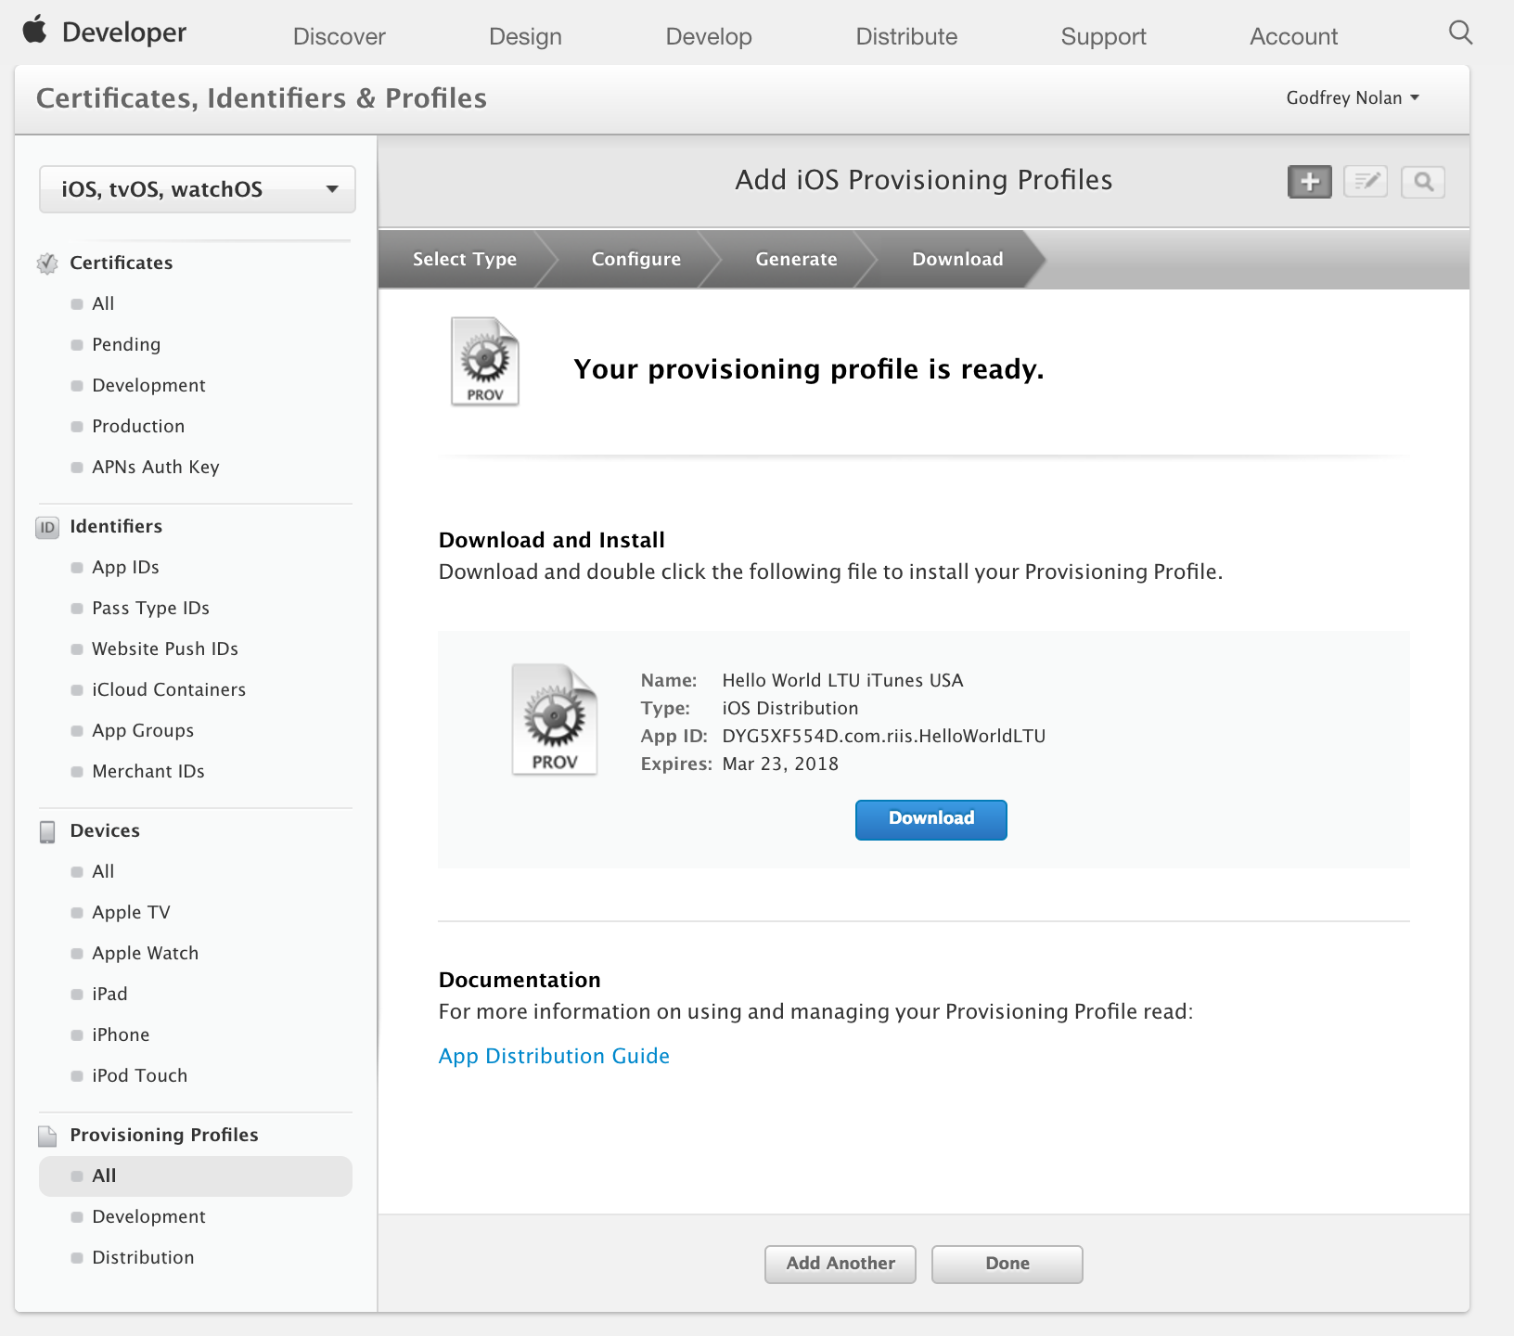
Notes:
In Apple Develper Portal go to Provisioning Profiles
Click the “+” in the top right of the screen
Click the App Store Distribution option, click Continue
Select the Bundle ID created earlier, click Continue
Select the Certificate created earlier, click Continue
Make sure the Profile Name follows the standard naming convention: App Name App Store Distribution
Click Generate Download it
Install the provision profile on your computer by double clicking
Keep this file somewhere safe

Slide 48
Create App Store Listing
Start in your browser, navigate to iTunes Connect
Log in
Click My Apps
Click the “+” in the top left of the screen
Click “New iOS App”
Bundle ID: choose the one created on Developer Portal
For convenience, make the SKU match the Bundle ID created earlier
Click Create to create the first version listing
Notes:
Reserve a slot in the App Store for your app for users to see.

Slide 50
Create App Store Listing
Start Xcode & Open the project or workspace
Update the version and build numbers
Open Build Settings, Make sure All settings is selected, Scroll to Code Signing
Use the provisioning profile created earlier
Use the code signing identity created earlier
In the top menu, select Generic iOS Device as the build destination if no actual device is connected
Go to Product Archive, Click ‘Upload to App Store’
Sign in as your apple developer account
Submit to app store, Wait for the confirmation
Notes:
Reserve a slot in the App Store for your app for users to see.

Slide 51
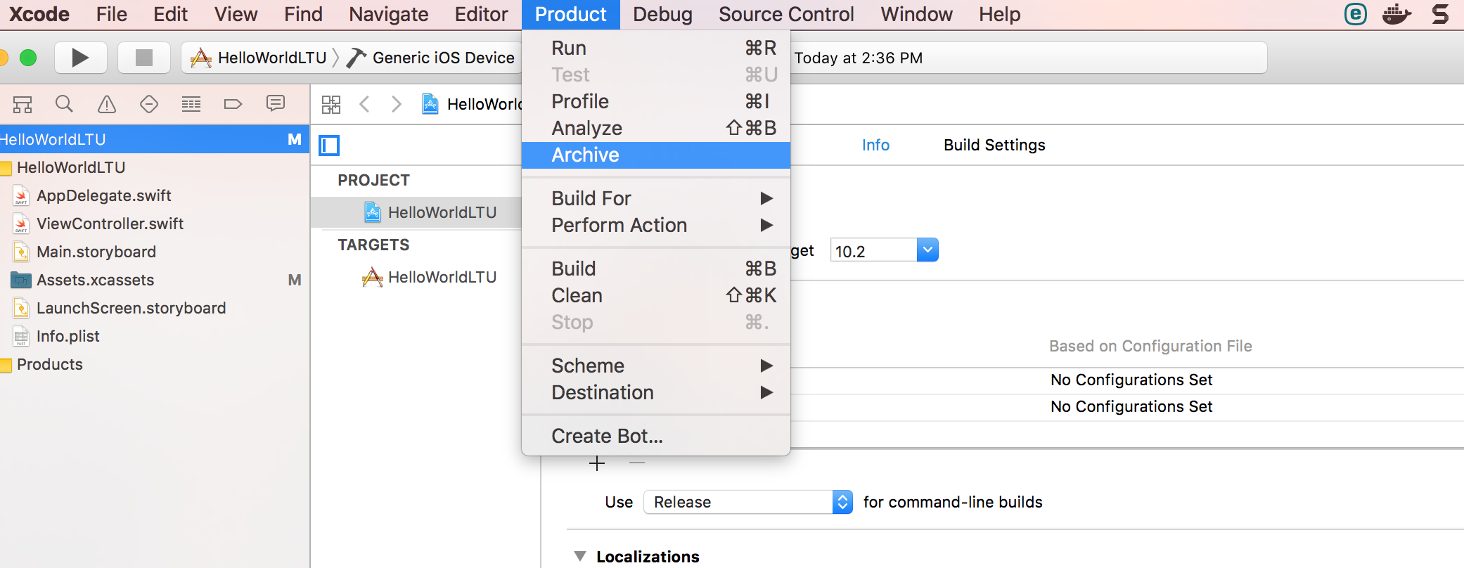
Notes:
Reserve a slot in the App Store for your app for users to see.

Slide 52
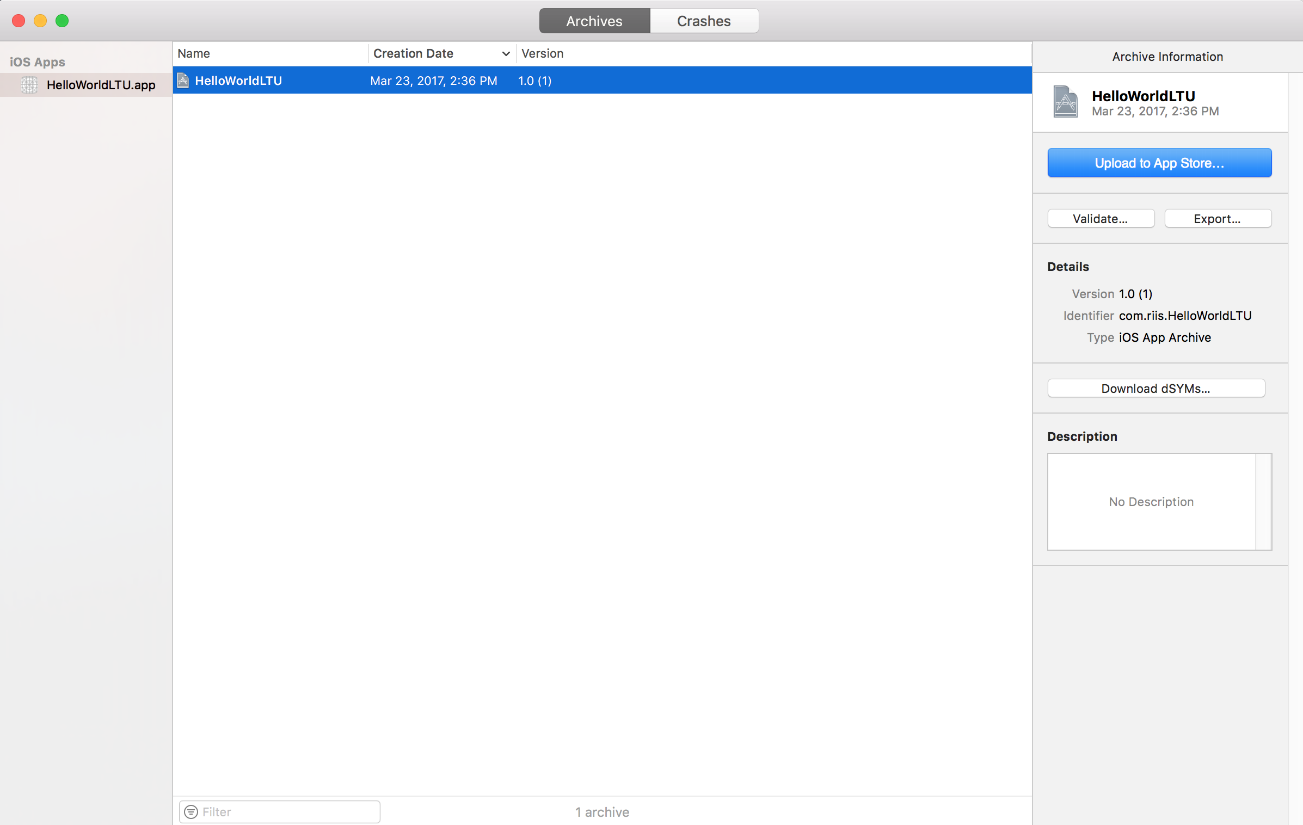
Notes:
Reserve a slot in the App Store for your app for users to see.

Slide 53
Fill In Version Information
Enter all of the information assembled in step 1
Select the build you wish to tie to the version (Note: This usually appears 10-15 minutes after sending from Xcode)
Fill in pricing information
Click Save
Fix any errors based on the messages that appear and save changes
Notes:
Users will decide whether or not to install your app based on your store listing

Slide 54
Submit Version for Review
Select the release type Manual release – after the app is accepted, a Release button will appear Automatic release – as soon as the app is accepted, it will be released Wait for approval
This process usually takes 2-3 weeks for a new submission
If your app was not approved, review the notes in the Resolution Center and make any necessary changes to the app or version information then resubmit
Notes:
Every app that is submitted to the store has to be reviewed by the Apple team before release.

Slide 55
Release
If you selected Manual release, click Release your app when ready
Wait for the green “Ready for Sale” version status (This might take from 1 hour to 1 day after release)
Search for your app on the App Store

Slide 56
Agenda
Tuesday
Unit testing
Create a table view with 3 transit companies in SQLite
Smart
DDOT
Reflex

